Slide 1
Pre-Production &
Design Prep Workshop
Stone Librande
Lead Designer, Riot Games
@StoneLibrande

Slide 2
Overview
Introduction
Paper prototyping
Lunch
One-page Designs
Design Jam
Pitches
Notes:
Overview

Slide 3
Pre-Production – Who Needs It?
Indie
Experimental and iterative
Small Studio
Work for hire
Large Studio
Work for the shareholders
No deadlines or budget
Rent and salaries
“Responsibility Profit”
Notes:
Pre-Production – Who Needs It?

Slide 4
Pre-Production Goals
Gather Information
Audience
Platform
Budget
Time
Money
People
Notes:
Goals – Gather Information

Slide 5
Pre-Production Goals
Identify Decision Makers
Executives
Marketing
Leads
Producer/Product Owner
Lead Engineer
Art Director
Notes:
Goals – Decision Makers

Slide 6
Pre-Production Goals
Overview Documents (Plans)
What we are doing
Pillars
What we are not doing
Design Wiki
Top-down information
Detail not as important as hierarchy
Notes:
Goals - Documents

Slide 7
Pre-Production Goals
Buy Off
Agreement from decision makers
Scheduling
Based on design wiki
Test plan
Based on design wiki
Notes:
Goals – Buy Off

Slide 8
Prototyping
Paper
Quick and cheap
Aligns team on basic concepts
Digital
Ultimate goal
Real-time feedback
Performance testing
User experience
Notes:
Prototyping

Slide 9
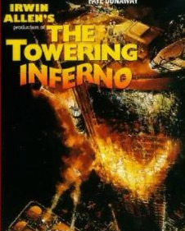
Notes:
Disaster Movies
Movies I couldn’t see when I was a kid…

Slide 10
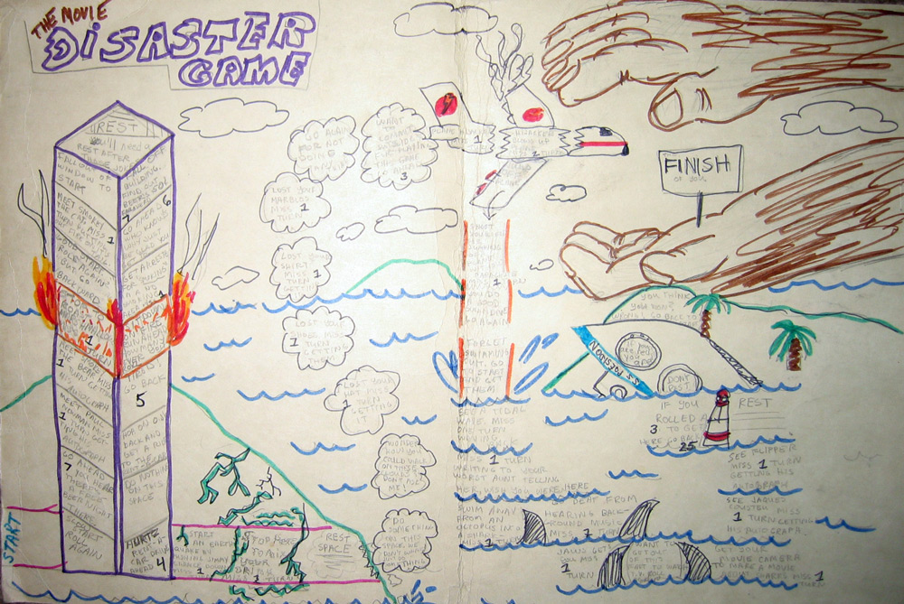
Notes:
…so I made board games about them.

Slide 11
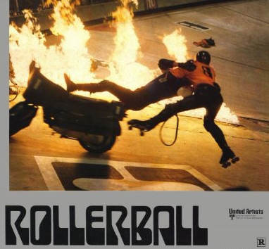
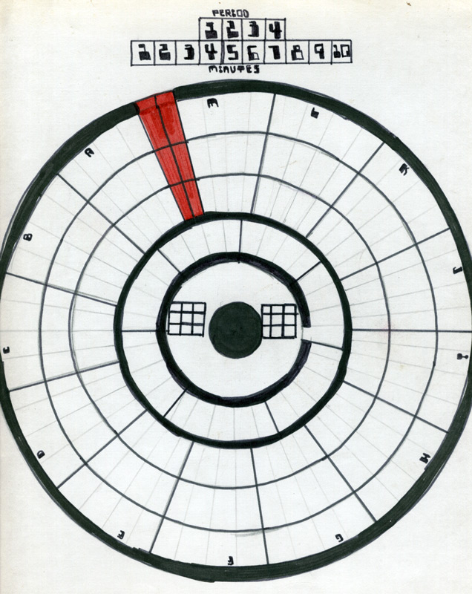
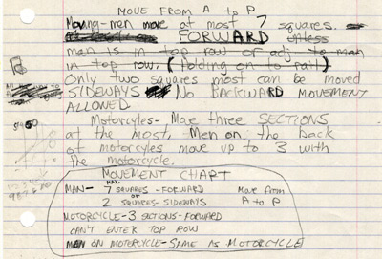

Slide 12
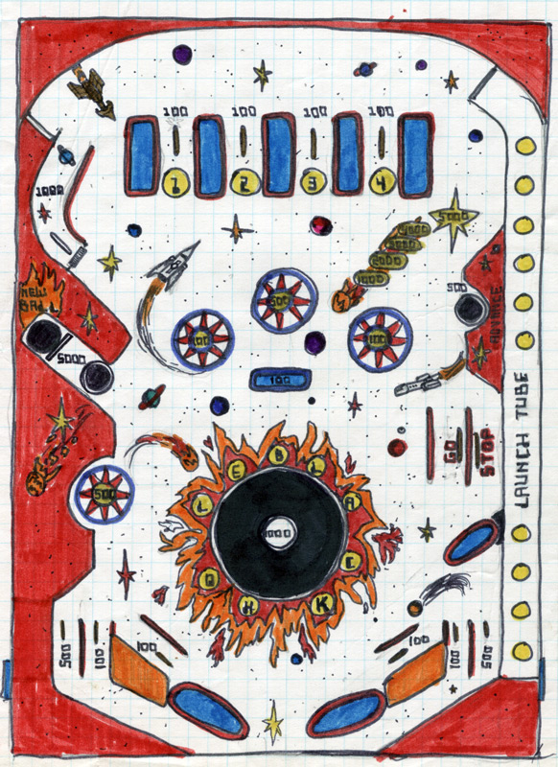
Notes:
And I was too young to play pinball, so I would make up my own tables on paper.

Slide 13
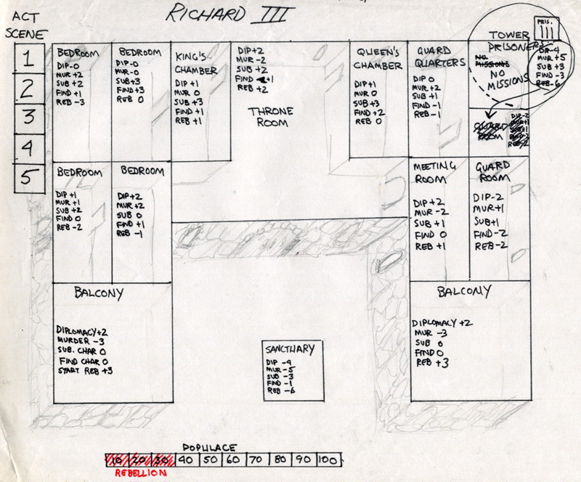
Notes:
Making games instead of writing essay for English Lit class.

Slide 14
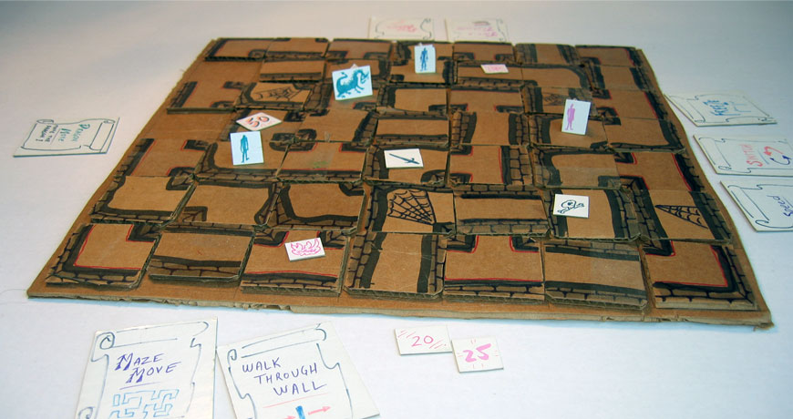
Notes:
Maze
Early cardboard prototype
This is the first version that made out of an old cardboard box and some magic markers. The tiles didn’t slide well and the game was basically unplayable.

Slide 15
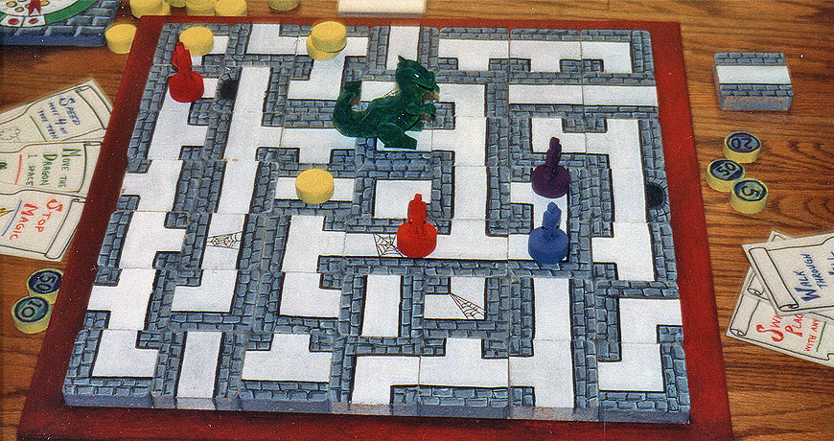
Notes:
Maze
Wood version
I borrowed my parents’ workshop when I was visiting for Christmas and cranked out a wooden version working late at night, right up until Christmas morning. There were no rules at this point; only a bunch of pieces. But after Christmas we played around with it and eventually came up with a solid game.

Slide 16
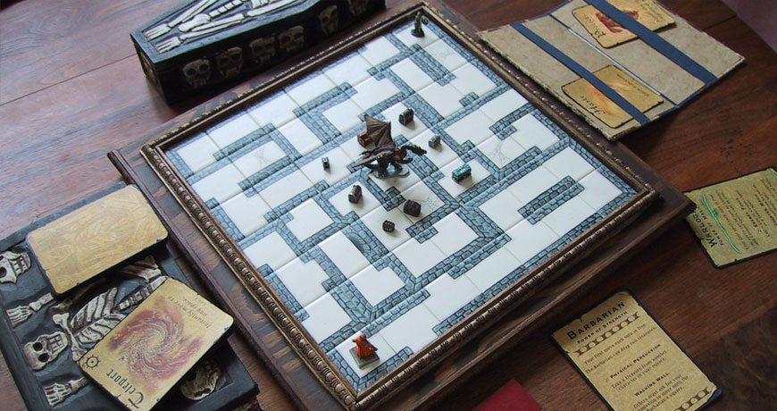
Notes:
Maze
Final version
Here are the current board and pieces. It is made out of wood and tile and hand-painted miniatures. This is about 5 years worth of work and iteration. I still have some ideas about how to make it better so who knows what it will look like 5 years from now.

Slide 17
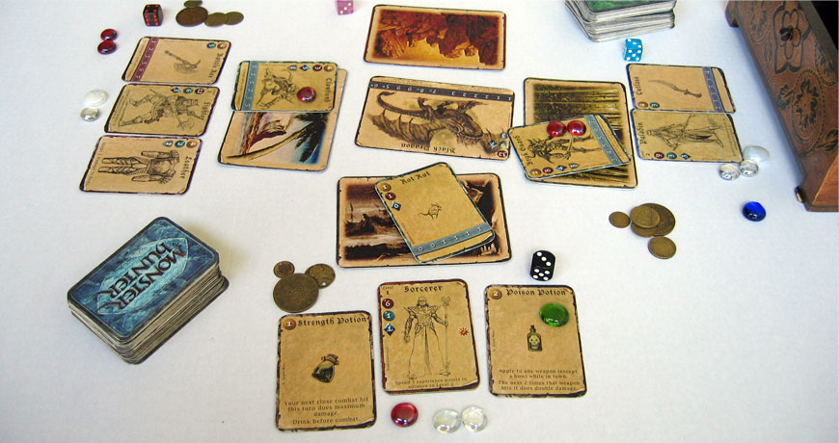
Notes:
Monster Hunter
A card game based on Diablo. The final game feels a lot like Diablo (or any other fantasy RPG) but plays out in 3 hours instead of several weeks. Players start out by fighting rats and the winner is the first to kill the dragon. Like Maze, there is no player vs. player combat. Players are free to cooperate or go solo, depending on their personality.

Slide 18
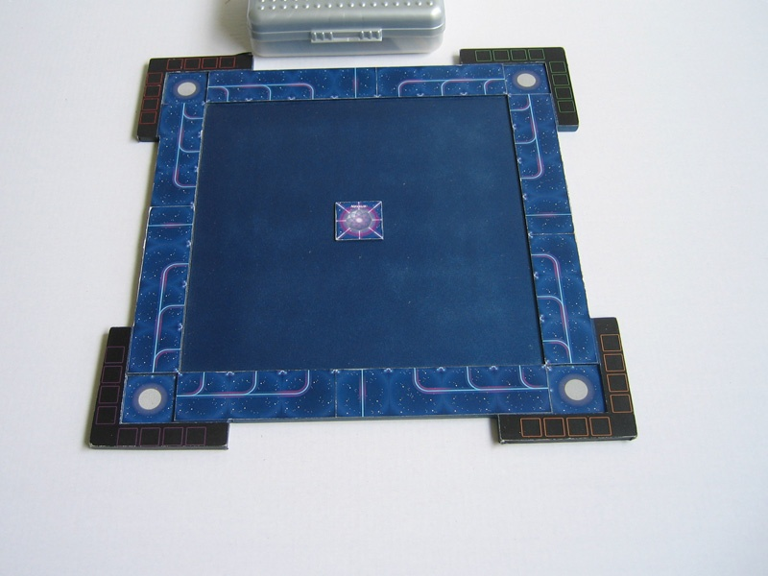
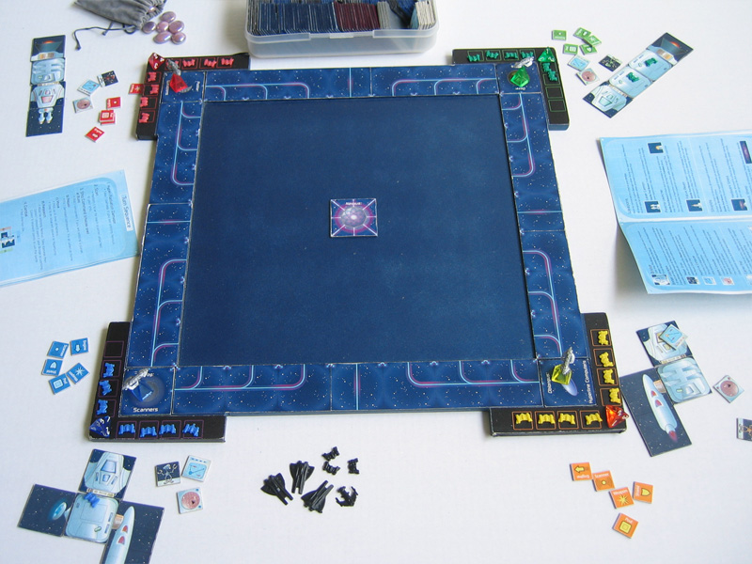
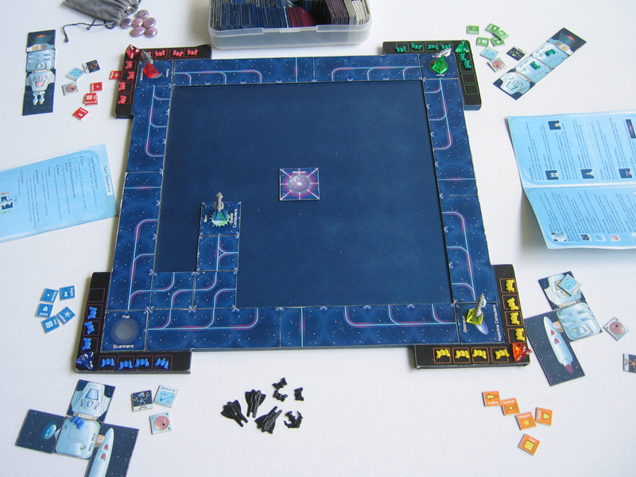
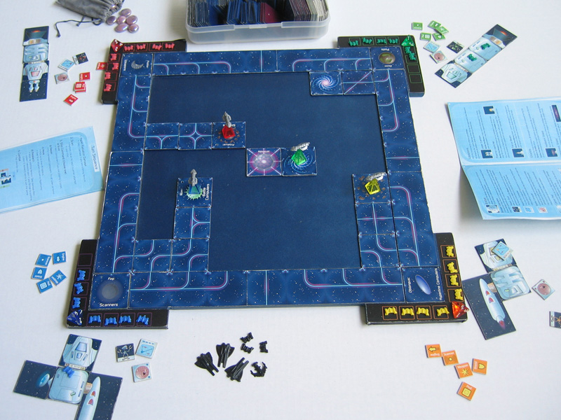
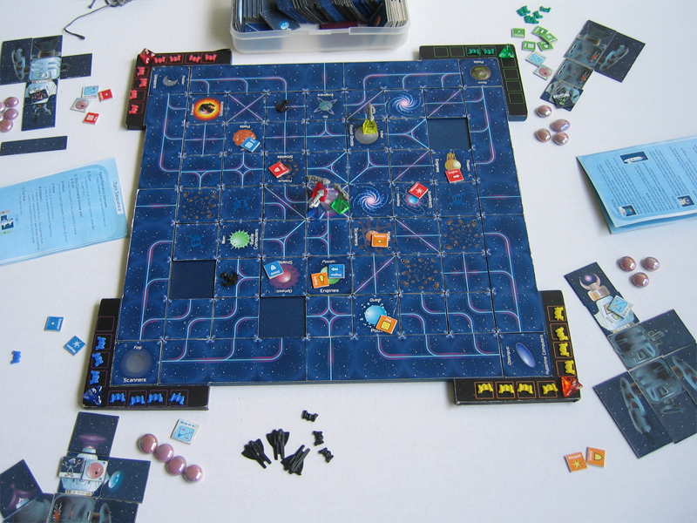
Notes:
Hyperline
A board game based on Masters of Orion. Players start out in the corners and attempt to reach the center to research Nexxus. Like a lot of my games for the family it is possible to achieve this goal without fighting. Each turn you explore the galaxy looking for technology on planets. As you gather technology your ship grows. The game plays out differently depending on your ship configuration. You can choose to focus on weapons, shields, engines or scanners.

Slide 19
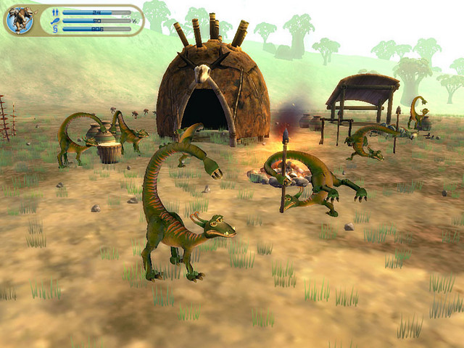
Notes:
Spore – GDC Talk

Slide 20
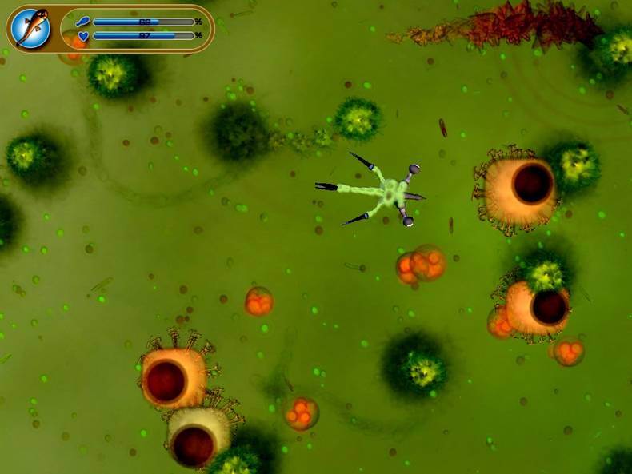
Notes:
Spore – GDC Talk

Slide 21
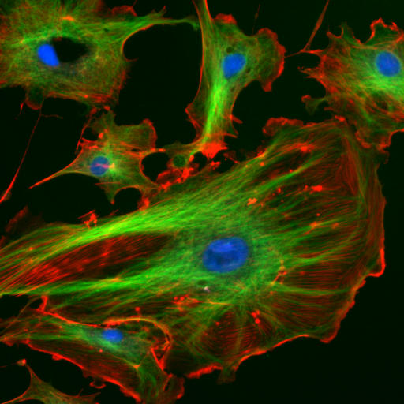
Eat and grow
Organic
Competition
Drop of water
Notes:
Without knowing much about Spore, I decided to make my own Cell Game.

Slide 22
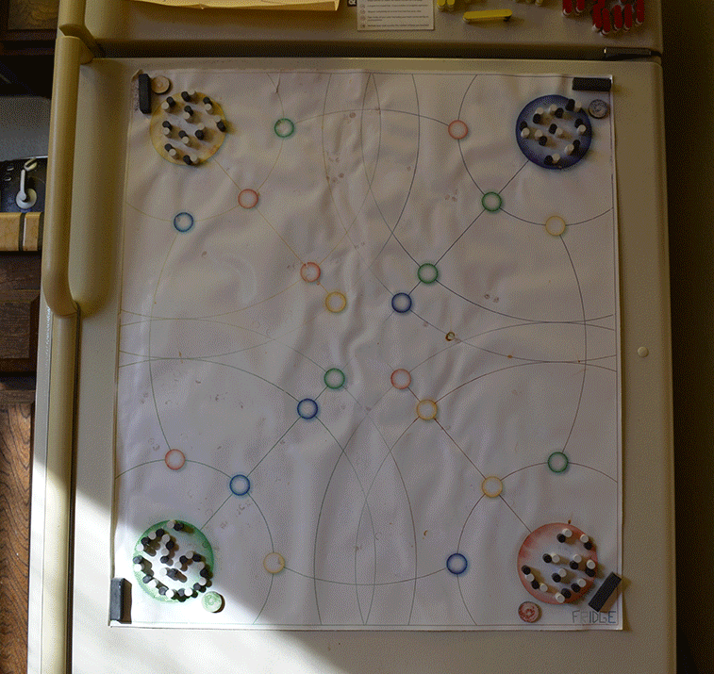

Slide 23
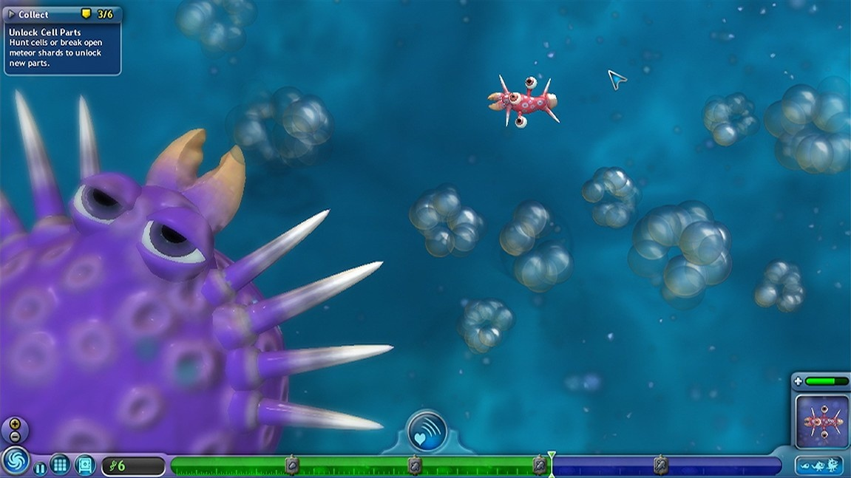
Notes:
But when I started working at Maxis I realized my game wasn’t much like the actual Cell Game.

Slide 24
Eat and grow
Organic
Competition
Pool of water

Slide 25
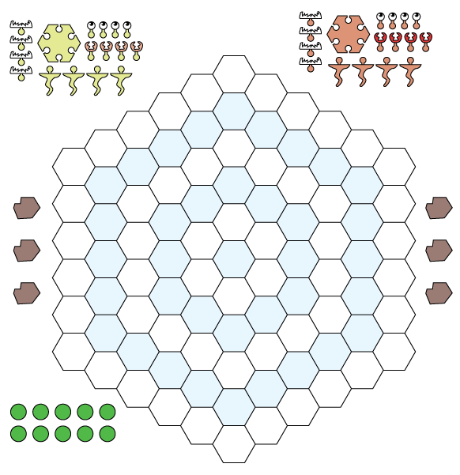
Notes:
I decided to make a better version on paper.

Slide 26
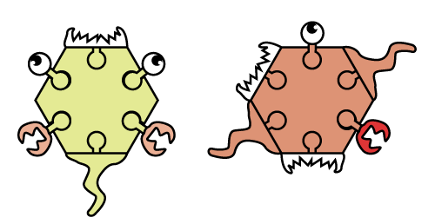
Limbs
Tails
Mouths
Eyes

Slide 27
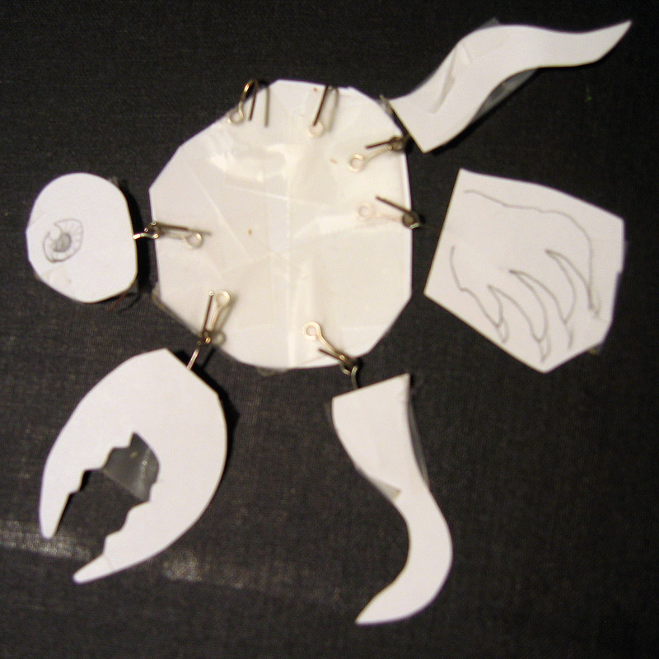

Slide 28
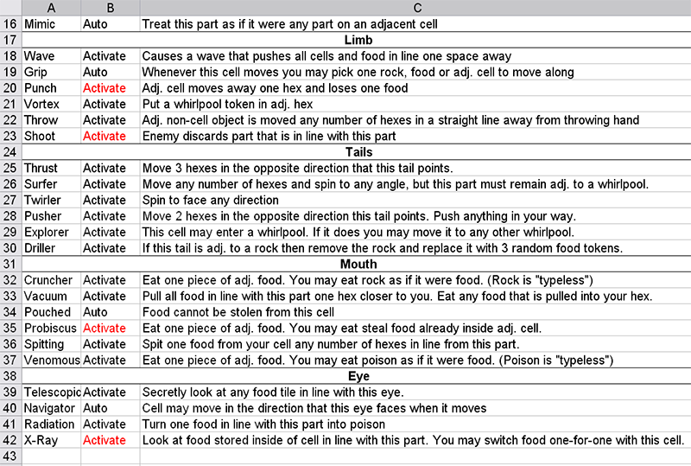

Slide 29
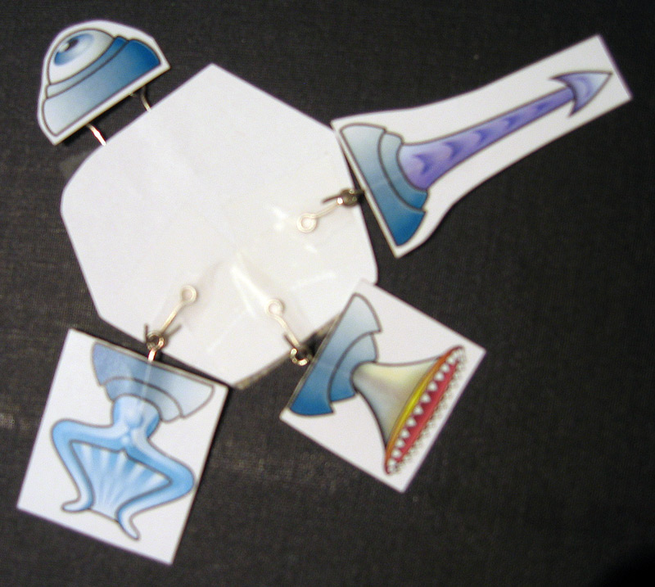

Slide 30
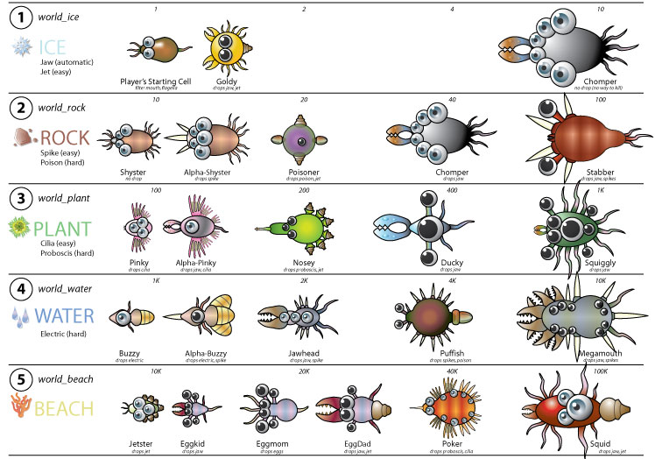
Notes:
Final list of enemy cells and their power-ups.

Slide 31
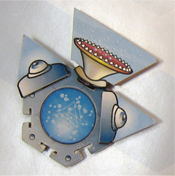
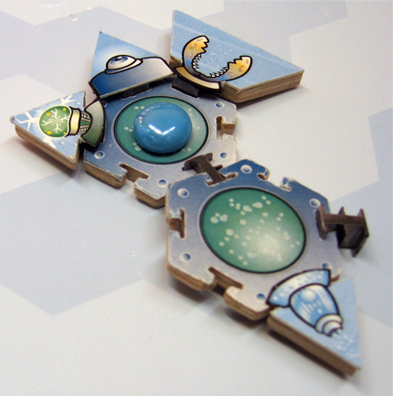
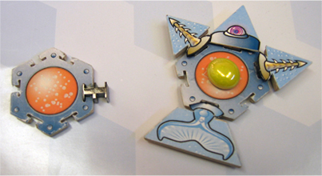
Notes:
A futuristic cell game prototype, “Nanobots”.

Slide 32
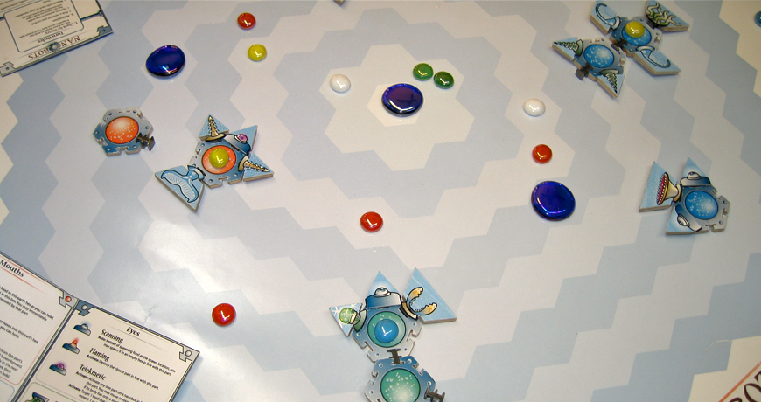

Slide 33
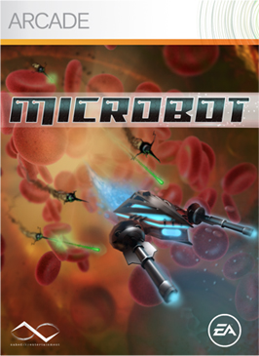
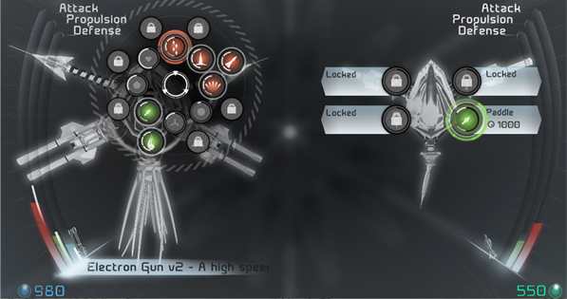
Notes:
“Nanobots” became the video game, “MicroBot”.

Slide 34
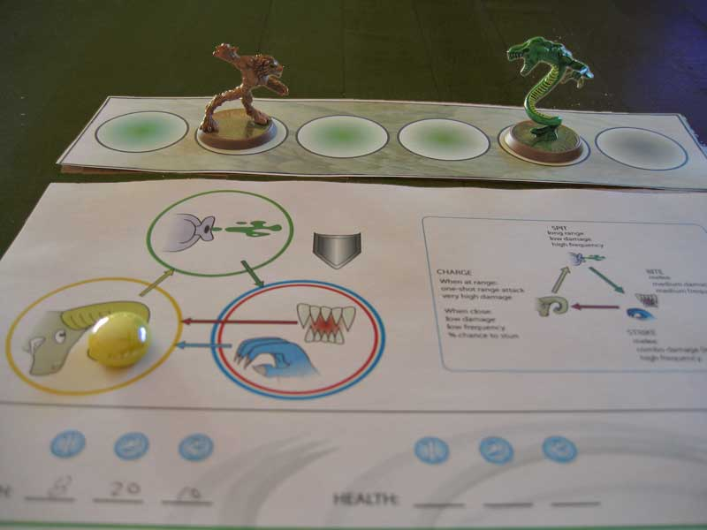
Notes:
Paper prototype for testing combat for the Creature Game in Spore.

Slide 35
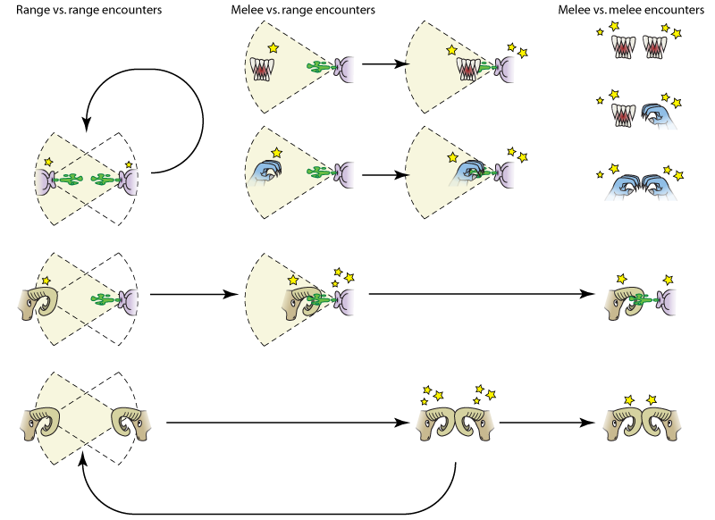

Slide 36
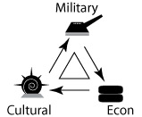
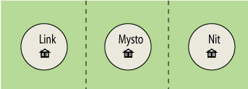
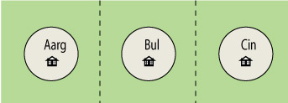
Notes:
Paper prototype for the Civ Game in Spore.

Slide 37
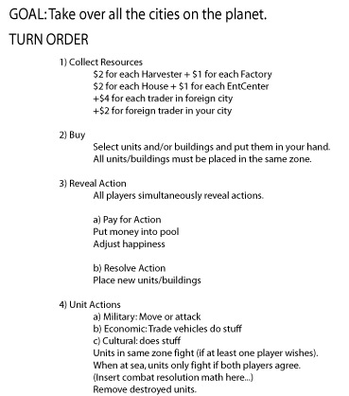
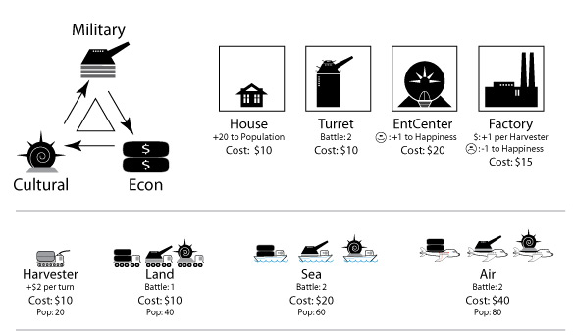

Slide 38
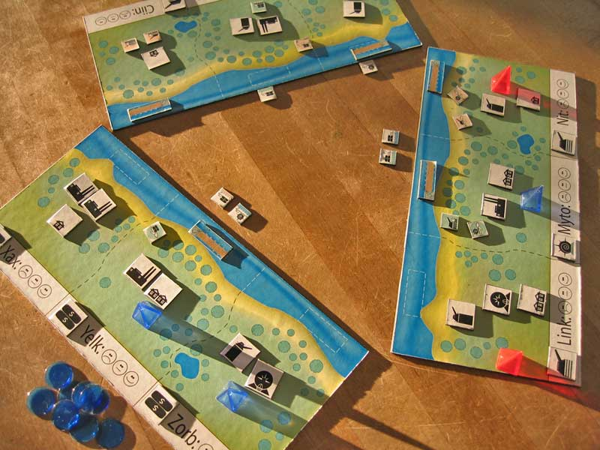

Slide 39
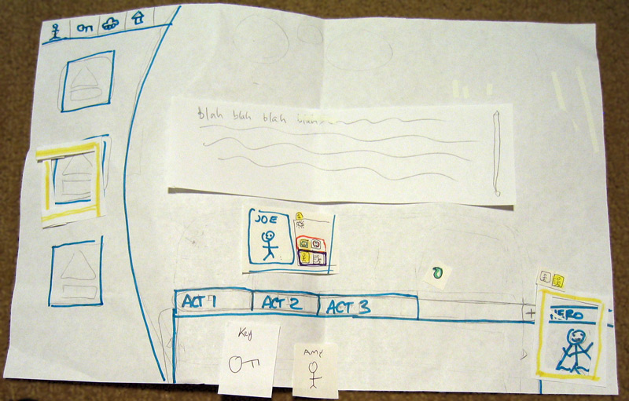
Notes:
Paper prototype for the Spore expansion pack, “Galactic Adventures”.

Slide 40
Creating Paper Prototypes
What to Do
Focus on one key idea at a time
Abstract as much as possible
What Not to Do
Don’t worry if the paper version is not “fun”
Don’t try to duplicate the entire game
Don’t simulate computer functions (math, physics, etc.)
Notes:
Creating Paper Prototypes

Slide 41
Working with Paper Prototypes
What are the benefits?
Quick and cheap. No artists or programmers required.
Gives you a head start.
Generates a shared vocabulary. To make your prototype you have to talk about your game.
Keeps the team’s imagination in sync. Everyone sees the same thing.
Notes:
Working with Paper Prototypes

Slide 42
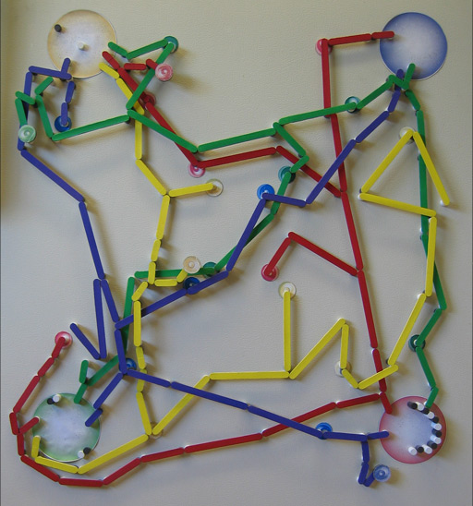
Notes:
My “cell” game was actually a better prototype for the Space Game in Spore.

Slide 43
