Slide 1
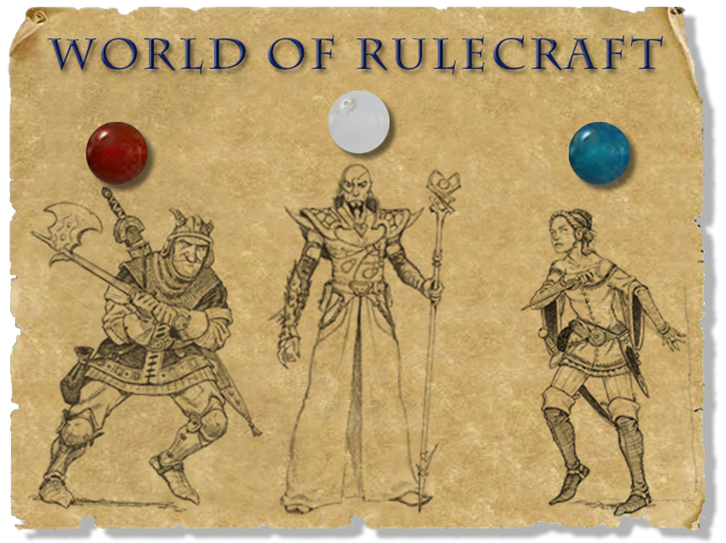
Stone Librande Lead Designer, Riot Games
Notes:
Intro
Hello, I’m Stone Librande, the Lead Designer on SimCity. I’ve been working on the game for over three years.
The game is huge and has many different aspects: multiplayer, cooperative play, competitive play, and sandbox mode. Every person in the city has an agenda and has a role to play in the city. There are over 25 major city systems, from education to power to sewage.
Keeping track of all of this was the most difficult design task I have faced in over 10 years of working on video games. To make the project even more interesting, I decided early on that I would use one-page design documents for the entire project to see how far I could push them. In this lecture I’ll talk about what worked and what didn’t, as I describe many of the documents.

Slide 2
Overview
Players divide into three groups based on character class: Fighter, Wizard and Thief.
Each group makes up rules for their character class.
Players duel each other and attempt to balance the classes while playing the game.
Notes:
Overview

Slide 3
Set Up
Pick a class: Fighter, Wizard or Thief
Take 5 beads based on your class:
Fighter: 3 red, 1 white, 1 blue
Wizard: 3 white, 1 blue, 1 red
Thief: 3 blue, 1 red, 1 white
Notes:
Set Up

Slide 4
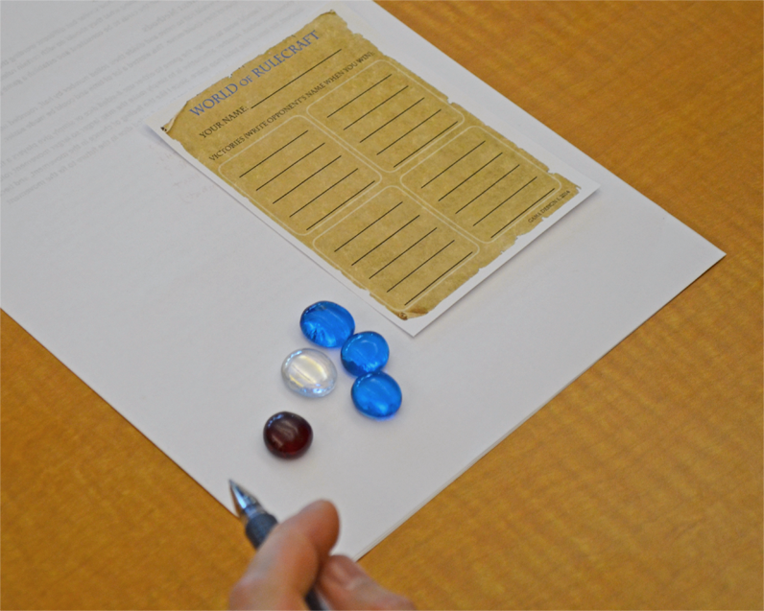
Set Up
Each player takes a character sheet and writes down his or her character’s name.
Encourage fantastical names!
Notes:
Set Up

Slide 5
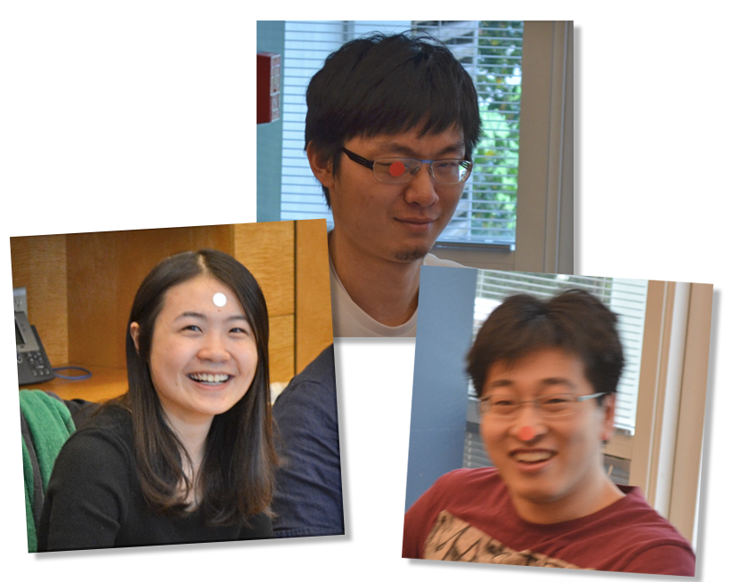
Set Up
Each player gets one colored sticker.
Each sticker represents one level.
Notes:
Set Up

Slide 6
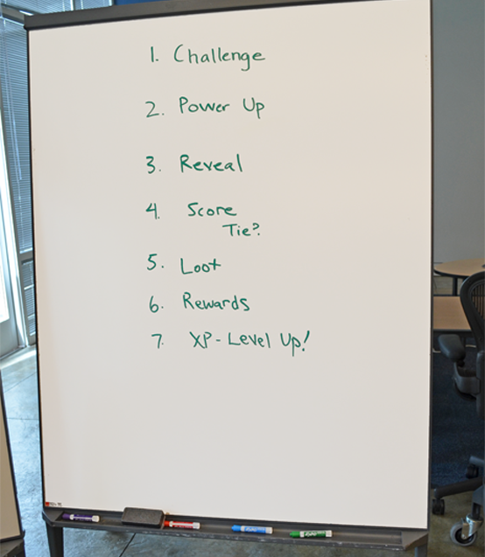
Turn Order
Write the Turn Order up on a white board.
Refer to it frequently throughout the exercise.
Notes:
Turn Order

Slide 7
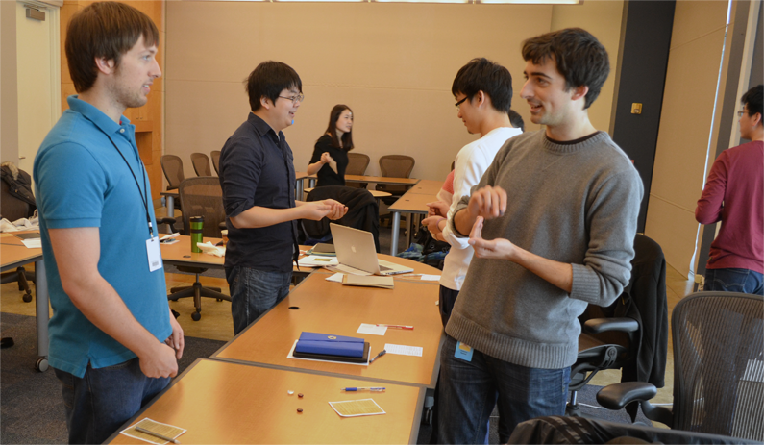
Challenge
Find someone to duel.
They can’t refuse unless they are a lower level than you are.
Notes:
Challenge

Slide 8
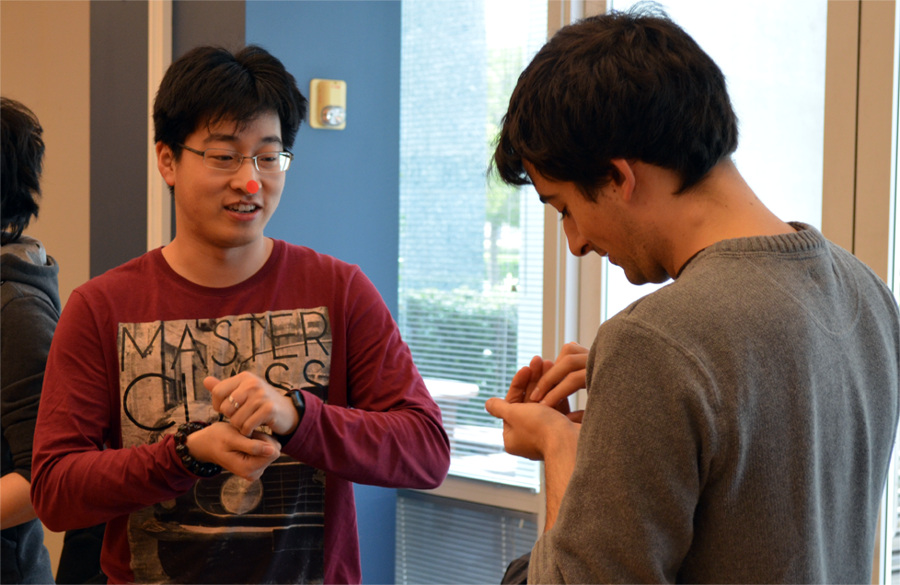
Power Up
Secretly put 1 or more beads in your hand.
Notes:
Power Up

Slide 9
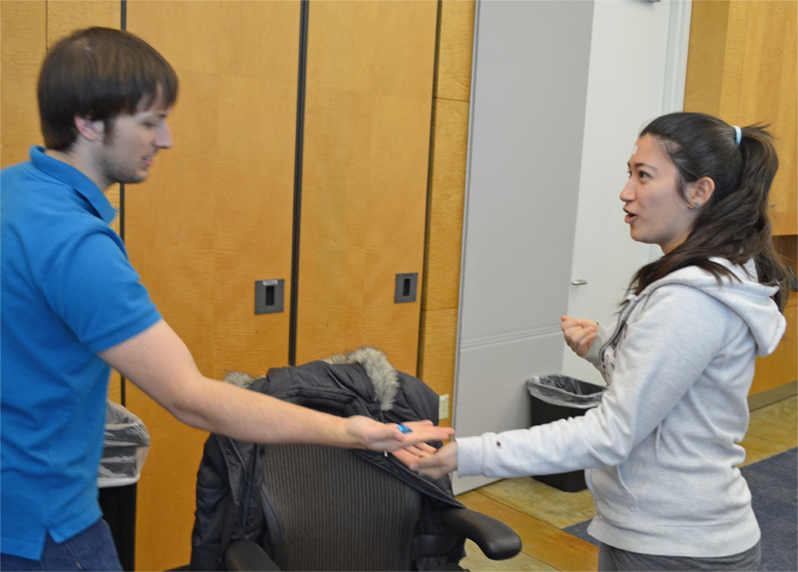
Reveal
Simultaneously show your beads.
Notes:
Reveal

Slide 10
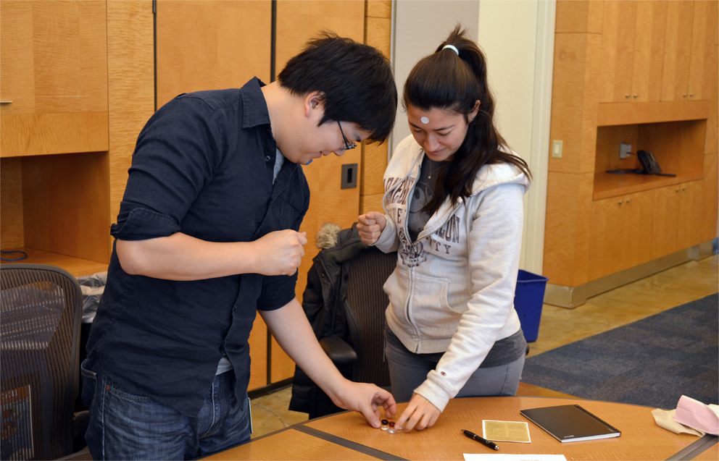
Score
Each duelist gets 1 point per bead + his or her current level.
Tie? Take back your beads and duel again.
Notes:
Score

Slide 11
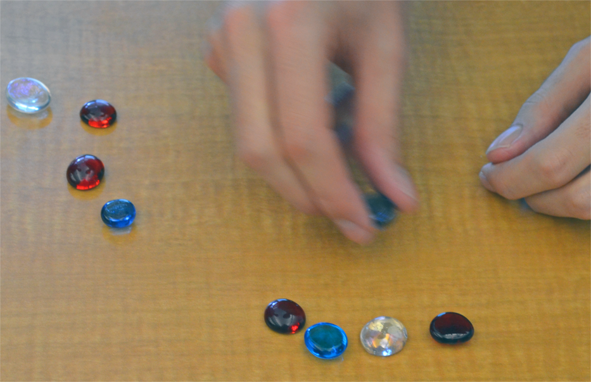
Loot
All beads involved in this duel go into a pool. The winner divides them into 2 equal piles.
(If there are an odd number of beads, one pile will have 1 extra.)
Notes:
Loot

Slide 12
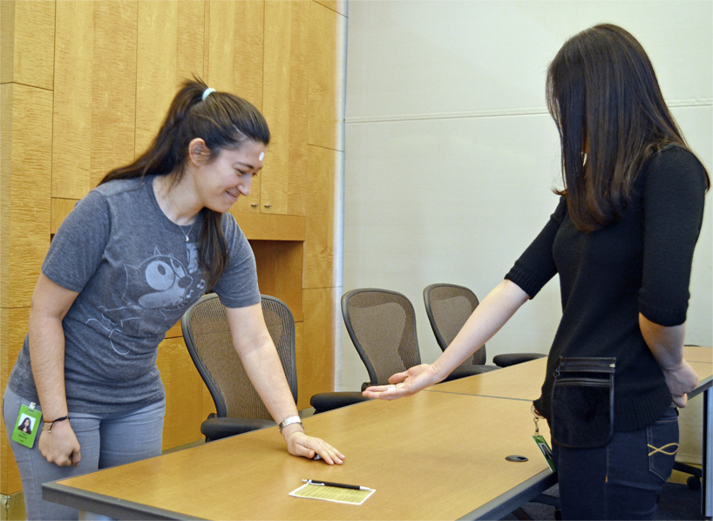
Rewards
Winner takes one of the piles and gives the other pile to the loser.
Notes:
Rewards

Slide 13
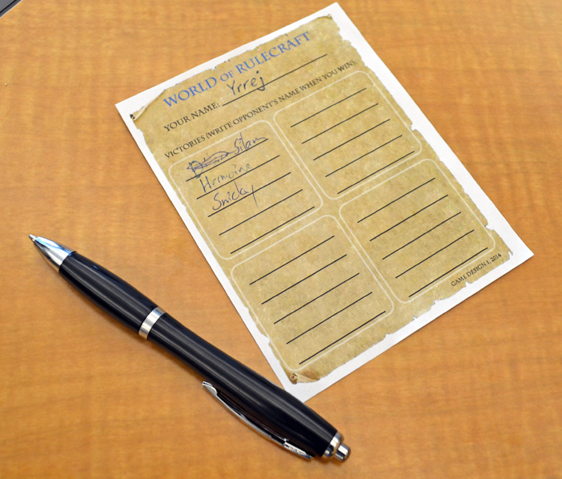
XP
Winner writes the loser’s name on his or her character sheet.
Notes:
XP

Slide 14
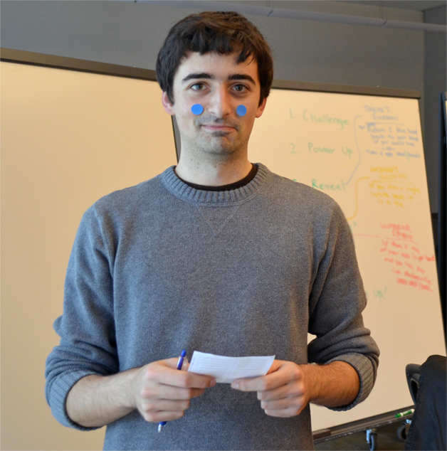
Level Up!
If you defeat 5 different opponents then your level increases by +1.
Get another sticker and one bead of your color.
Notes:
Level Up!

Slide 15
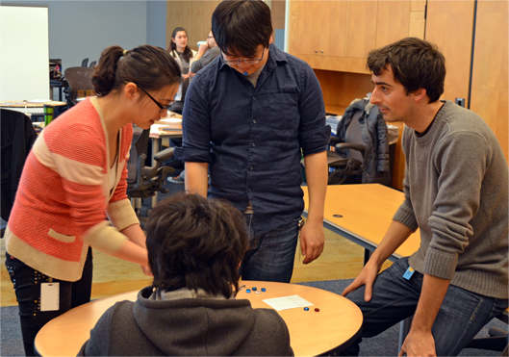
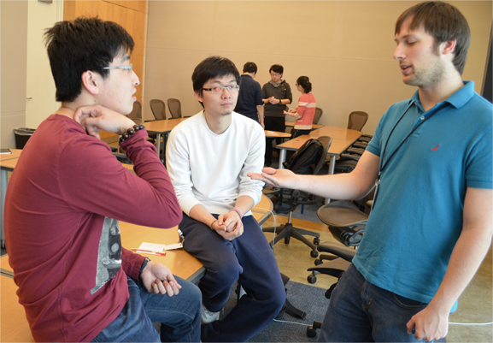
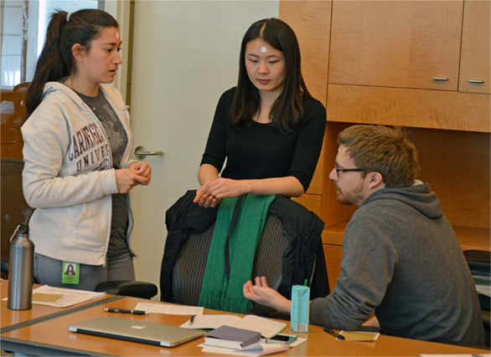
Character Rules
Break up into three groups:
Fighters’ Pub
Wizards’ Tower
Thieves’ Cave
Notes:
Character Rules

Slide 16
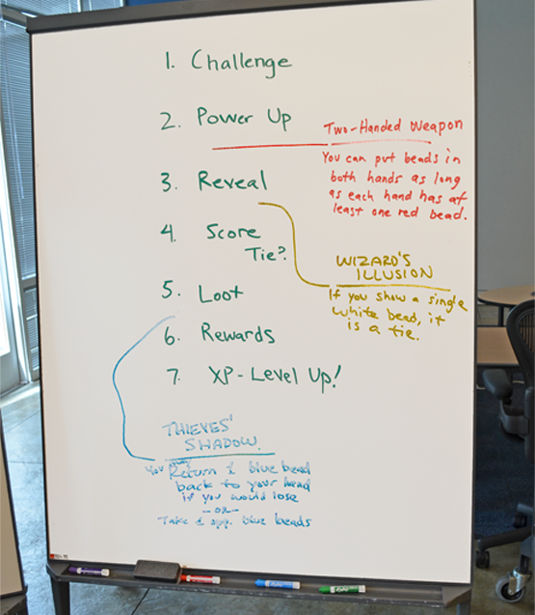
Character Rules
Make a rule about your character’s bead color.
Fit it into the Turn Order.
Regroup and discuss. Questions? Concerns?
Playtest and repeat.
Notes:
Character Rules

Slide 17
Rule Prompts
Death
Role identities
Economy:
-getting more beads in
-taking beads out
Team combat
Guilds
Other Level Bonuses
Scaling power by level
One rule for every step in the Turn Order
Notes:
Rule Prompts

Slide 18
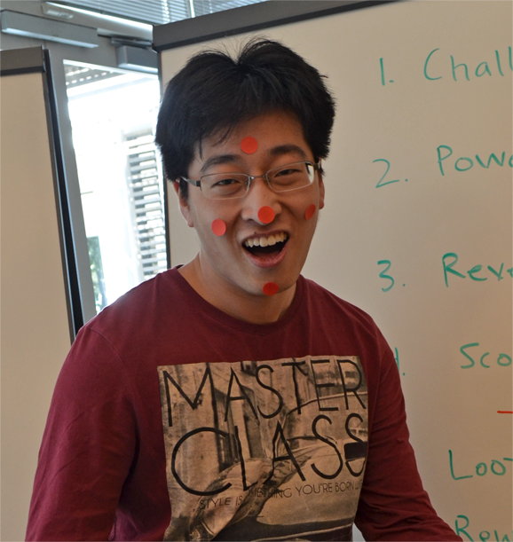
End of Game
There is no explicit end state. Play until you run out of time or a player reaches a certain level.
Compare power levels. Does each class have the same average number of stickers and beads?
Notes:
End of Game

Slide 19
Discussion Points
Balancing: Strengthen the weak or weaken the strong?
Opinions (forums) vs. objective data (telemetry).
Add new rules or modify existing rules?
Big projects have multiple design groups. How do they communicate and keep in sync?
Did the rules make you feel in character?
Notes:
Discussion Points

Slide 20
Thanks!
These slides and character sheets are available for download at: www.stonetronix.com
@StoneLibrande
Notes:
Thank You

