Slide 1
Design Jam
A game design exercise
Stone Librande Lead Designer, Riot Games
Notes:
Intro
Hello, I’m Stone Librande, the Lead Designer on SimCity. I’ve been working on the game for over three years.
The game is huge and has many different aspects: multiplayer, cooperative play, competitive play, and sandbox mode. Every person in the city has an agenda and has a role to play in the city. There are over 25 major city systems, from education to power to sewage.
Keeping track of all of this was the most difficult design task I have faced in over 10 years of working on video games. To make the project even more interesting, I decided early on that I would use one-page design documents for the entire project to see how far I could push them. In this lecture I’ll talk about what worked and what didn’t, as I describe many of the documents.

Slide 2
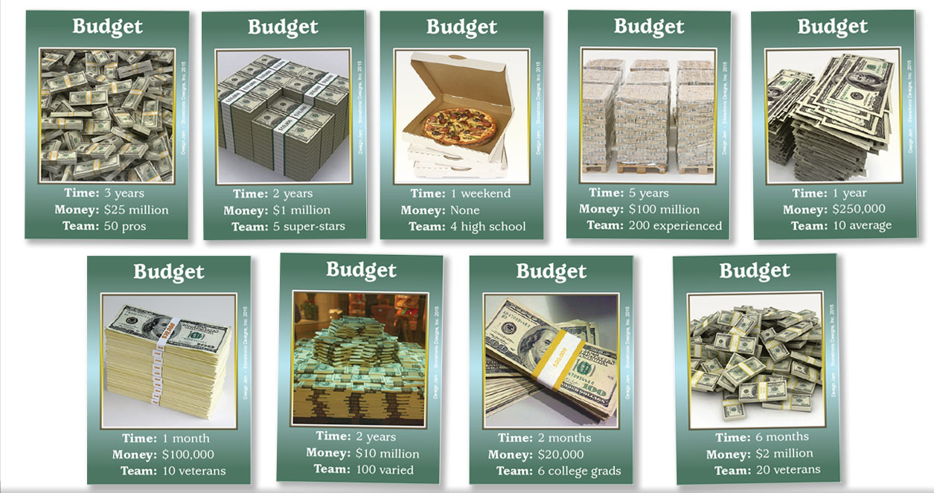

Slide 6
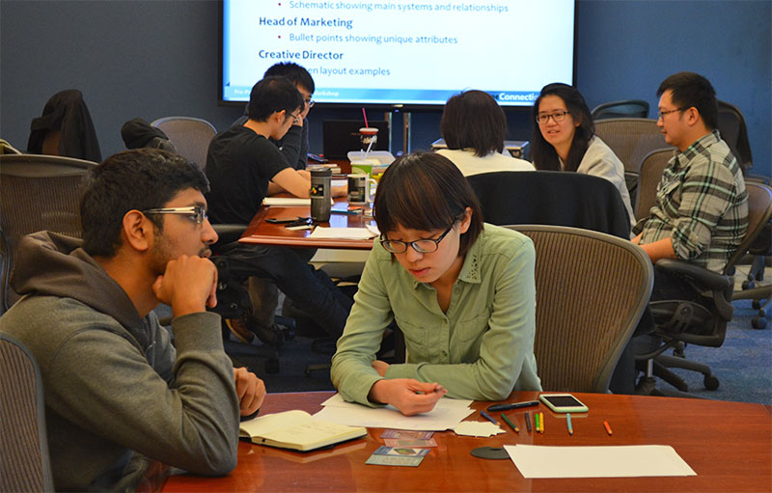
Overview
Split up into small teams
2-3 people per team
Brainstorm
Get “assignment”
Discuss the situation for 5-10 minutes
Create design documents
Presentation
4 minute “pitch”
Notes:
Overview

Slide 8
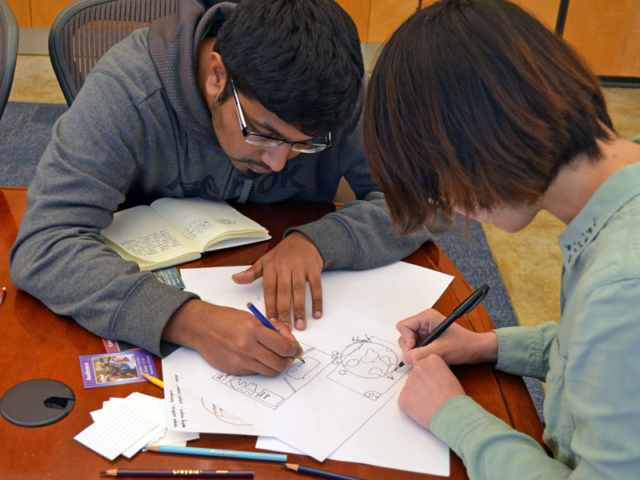
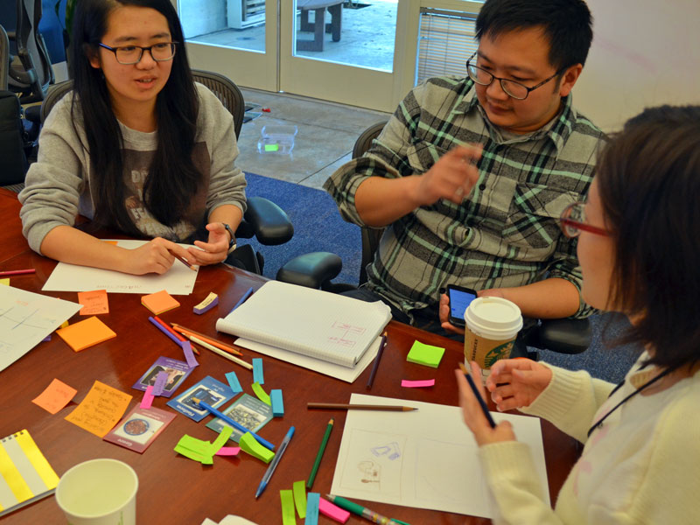
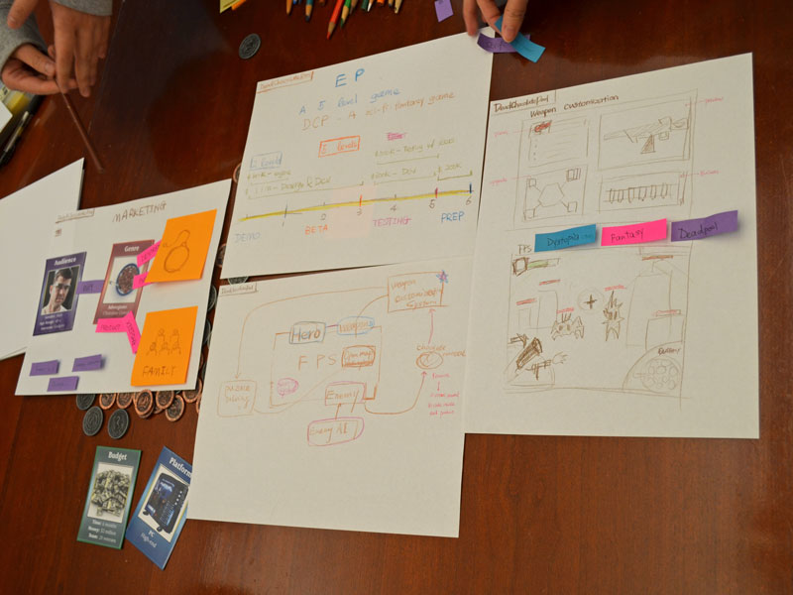
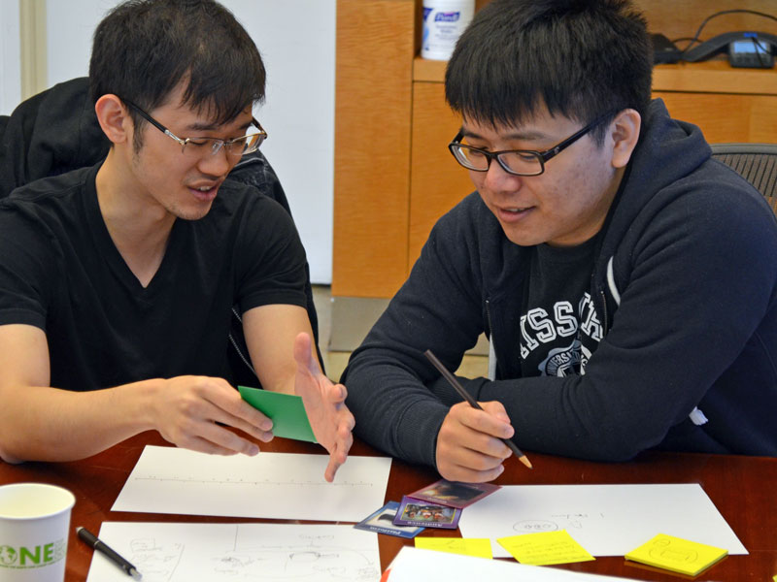

Slide 9
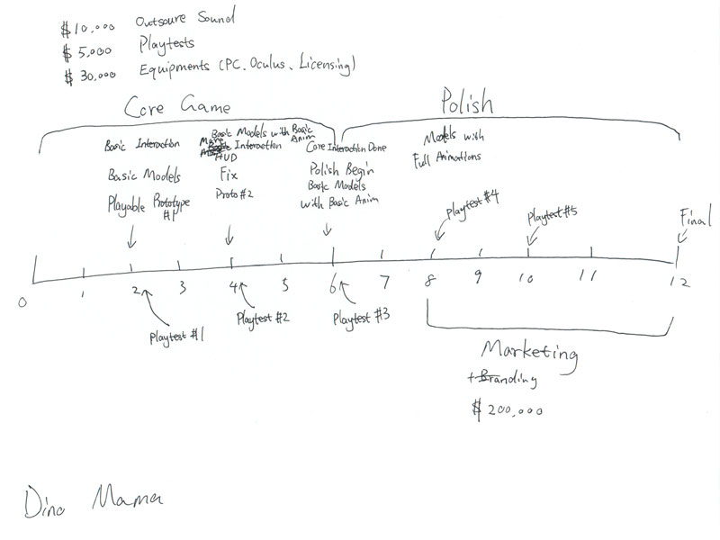
Design Documents
Executive Producer
Timeline from beginning to end of production
Notes:
Overview

Slide 10
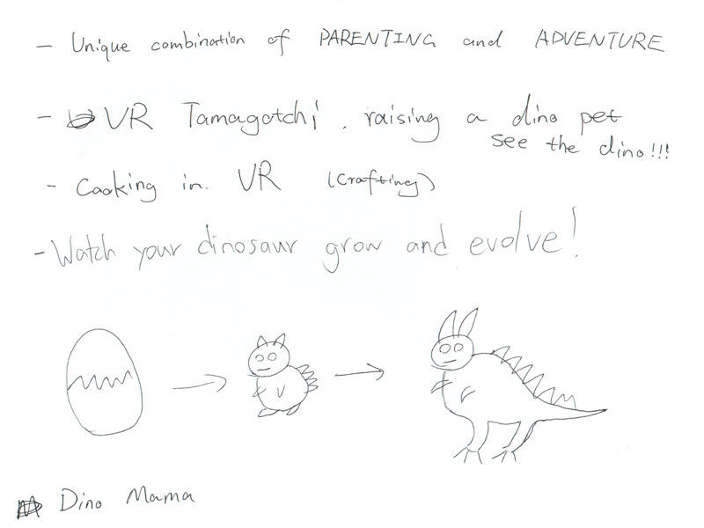
Design Documents
Head of Marketing
Bullet points showing unique attributes
Notes:
Overview

Slide 11
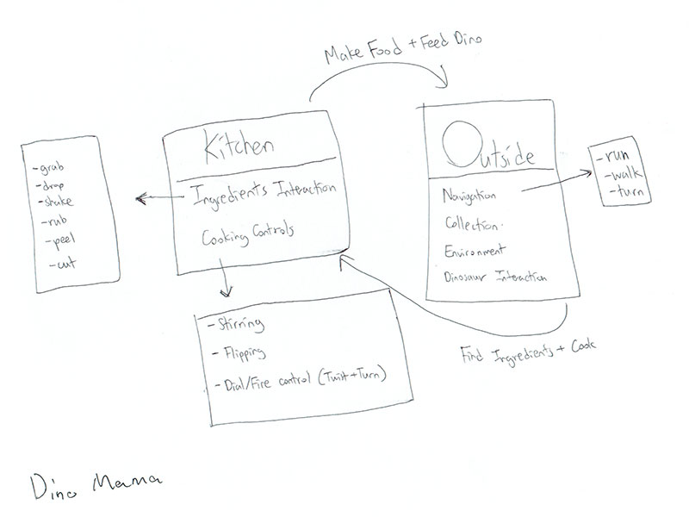
Design Documents
Lead Engineer
Schematic showing main systems and relationships
Notes:
Overview

Slide 12
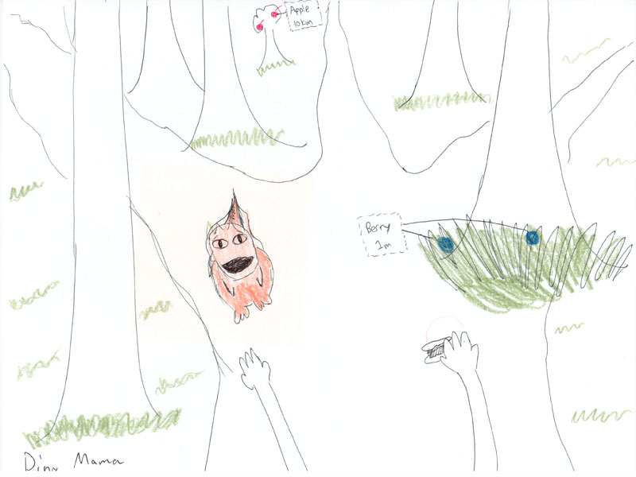
Design Documents
Creative Director
Screen layout examples
Notes:
Overview

Slide 13
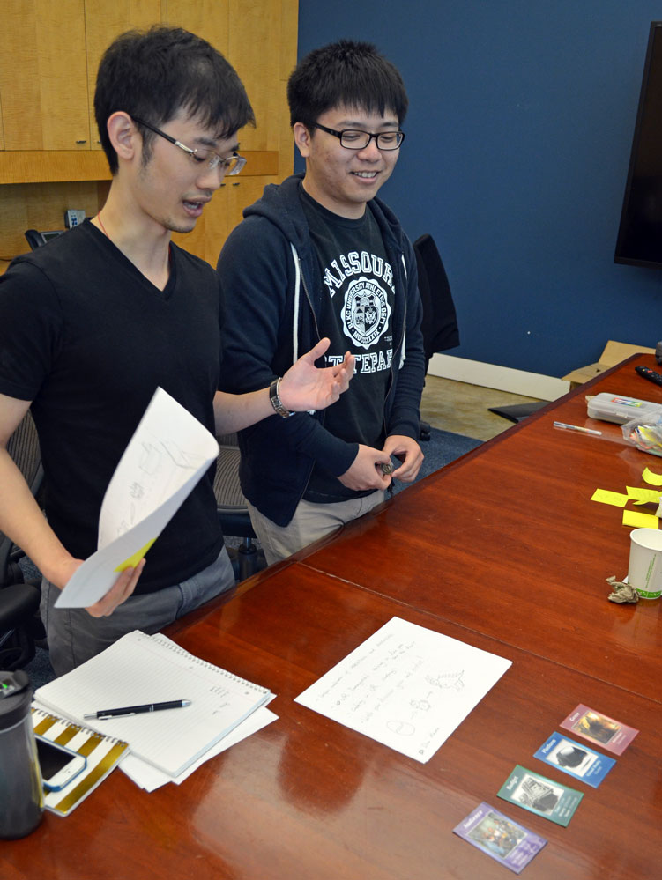
Wrapping Up
Pitches
4 minutes per team
~1 minute per document
Question & Answer period
Shhh…
(Pitches aren’t that important.)
Notes:
Overview

Slide 14
Homework
Project Document
Analyze your current project
Create a one-page design that describes a key feature
Present it to your team
Incorporate their feedback
Notes:
Overview

Slide 15
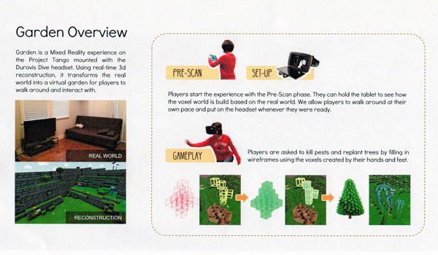
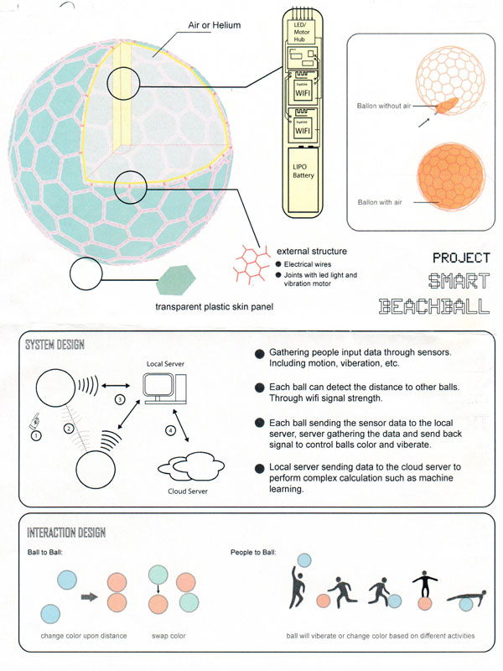
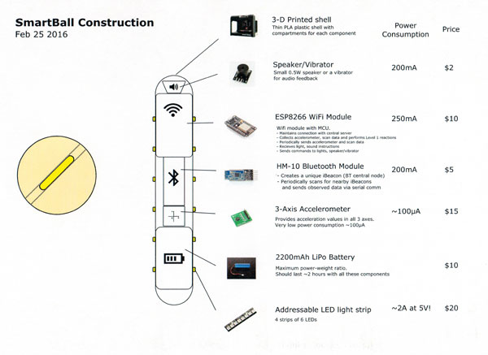
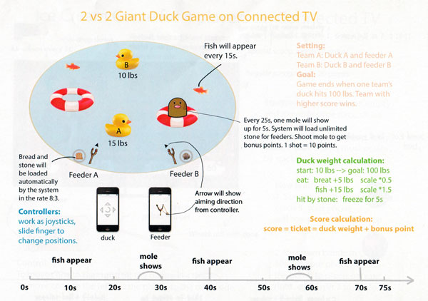
Homework
Notes:
Overview

Slide 16
Key Takeaways
Focus on design, not on the game
Designer isn’t the one “in charge”
Working within tight constraints
Process is quick and valuable
Apply techniques to a real world project
Notes:
Discussion Points

Slide 17
Design Jam cards and rules are available for download at: www.stonetronix.com
@StoneLibrande
Notes:
Thank You

