Slide 1
Us vs. It:
MDA in Practice
Marcus Montgomery
Stone Librande

Slide 2
The MDA Framework
Mechanics
Dynamics
Aesthetics
Notes:
2

Slide 3
What is the relationship?
“Rules”
“Fun”
Notes:
3

Slide 4
A causal flow
“Rules”
“Activity”
“Fun”
This is what sets games apart…
Notes:
4

Slide 5
Games As Software
“Rules”
“Activity”
“Fun”
Code
Process
Requirements
Notes:
5

Slide 6
A Design Vocabulary
“Rules”
“Activity”
“Fun”
Code
Process
Requirements
Notes:
6

Slide 7
A Design Vocabulary
Mechanics
“Activity”
“Fun”
Process
Requirements
Notes:
7

Slide 8
A Design Vocabulary
Mechanics
Dynamics
“Fun”
Requirements
Notes:
8

Slide 9
A Design Vocabulary
Mechanics
Dynamics
Aesthetics
Notes:
9

Slide 10
The MDA Framework
Mechanics
Dynamics
Aesthetics
What do we mean?
Notes:
10

Slide 11
Mechanics
The concepts and materials that formally specify the game-as-system.
Everything you need to play
Not just rules
Not just “Systemic Building Blocks”

Slide 12
Dynamics
The run-time behavior of the game-as-system.
The systems in motion
What happens when you play

Slide 13
Aesthetics
The emotional content of the game.
How players feel when they play
Not just visual or sensory qualities
Cognitive rather than Behavioral

Slide 14
This is a systems view of games
Input
Output
Logic
State

Slide 15
The Designer/Player Relationship


Mechanics
Dynamics
Aesthetics
Designer
Player
Notes:
15

Slide 16
The Player’s Perspective

Mechanics
Dynamics
Aesthetics
Player
Notes:
16

Slide 17
The Designer’s Perspective

Mechanics
Dynamics
Aesthetics
Designer
Notes:
17

Slide 18
Design Exercise: Us vs. It
Mechanics: Predefined and highly constrained
Dynamics: Play the game vs. an “AI” that you create
Aesthetics: Improve the drama

Slide 19
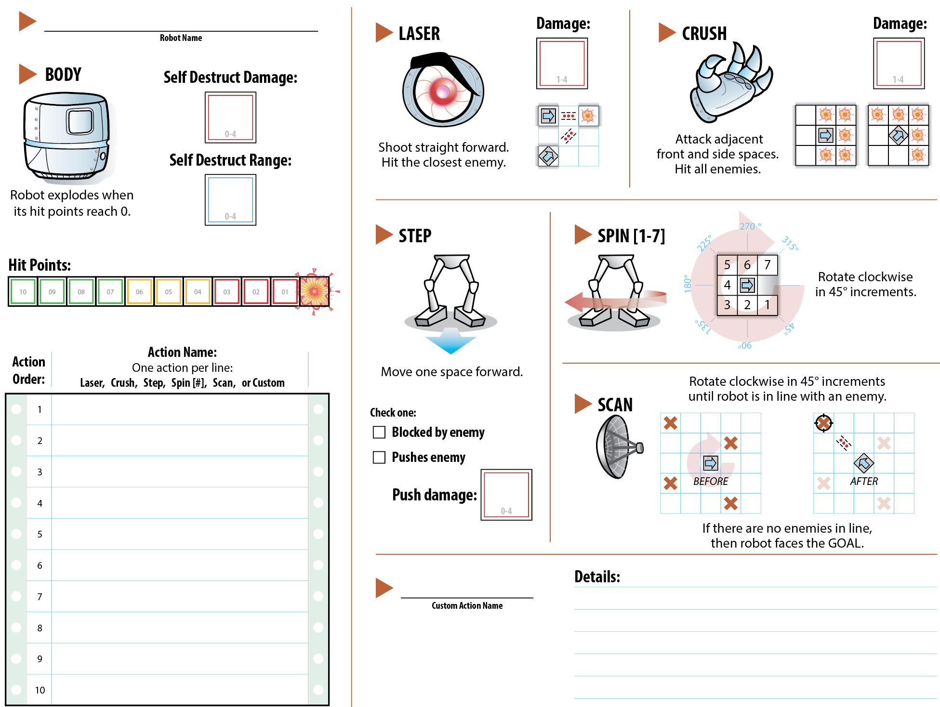
PHASE 1: Create Robot AI
Fill out your robot’s programming sheet
  How does it move?
  How does it attack?
  What special abilities does it have?

Slide 20
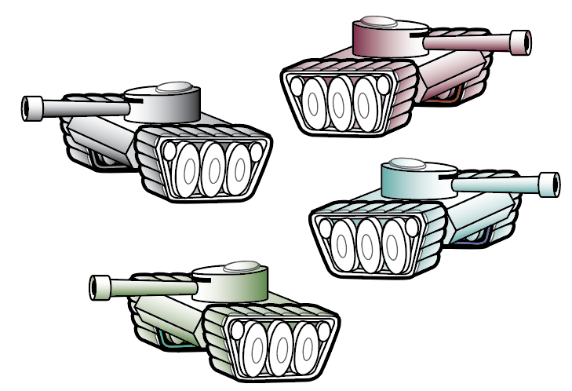
PHASE 2: Destroy it with Tanks!
Cooperate with your teammates
Maneuver tanks into position
Attack the robot
Don’t let it reach the nearby town!

Slide 21
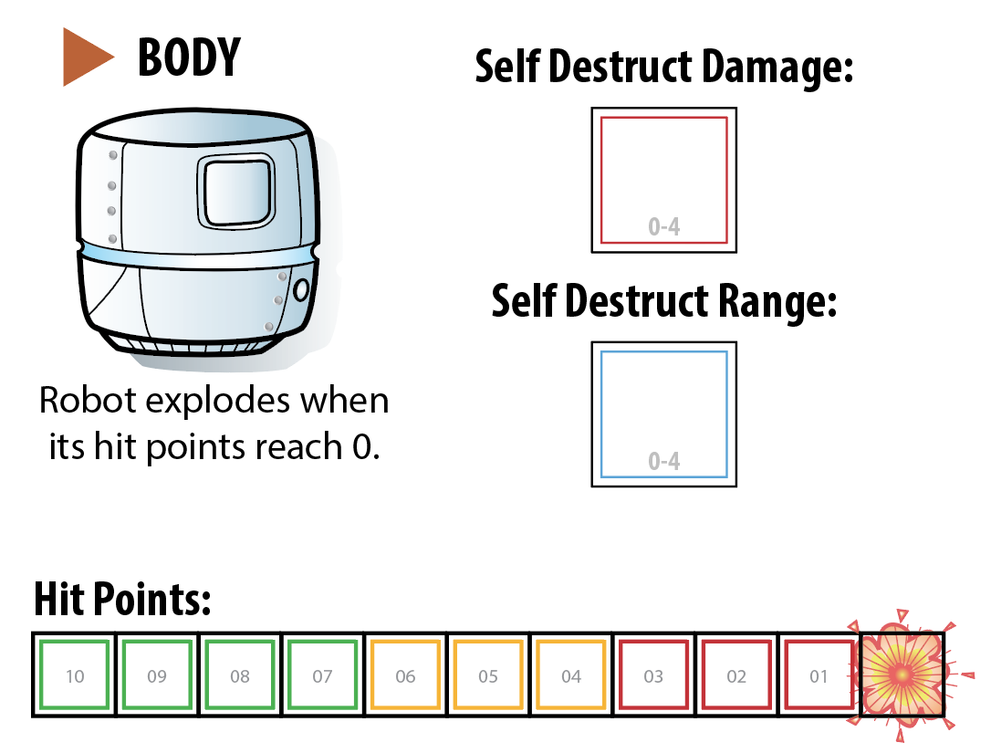
The Robot

Slide 22
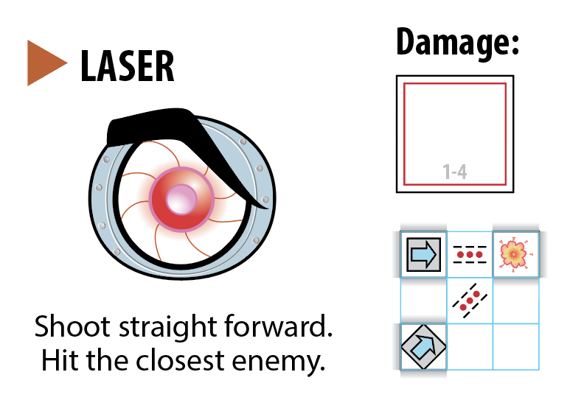
The Robot

Slide 23
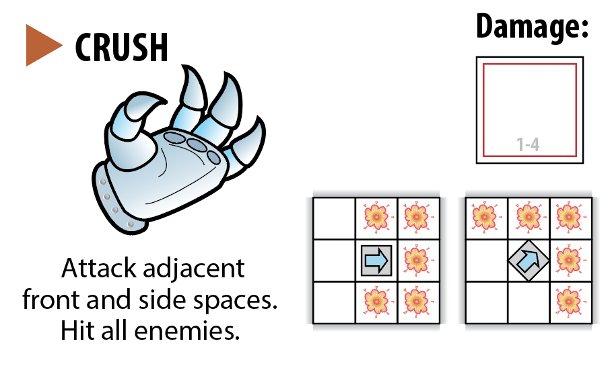
The Robot

Slide 24
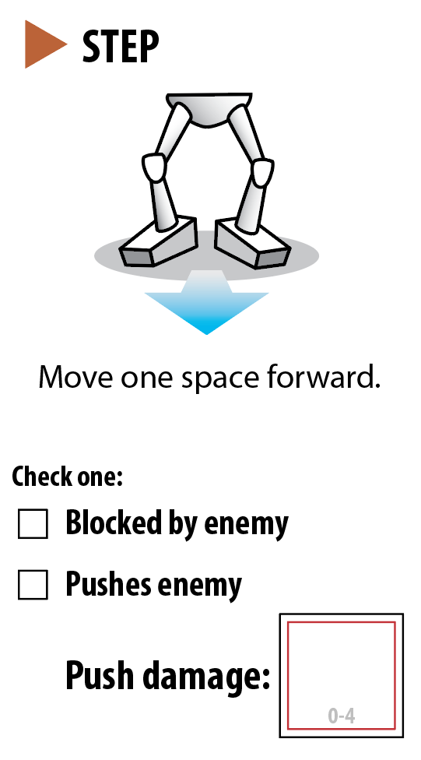
The Robot

Slide 25
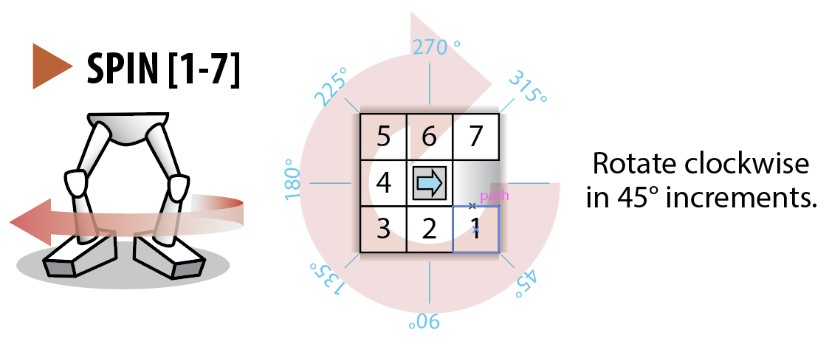
The Robot

Slide 26
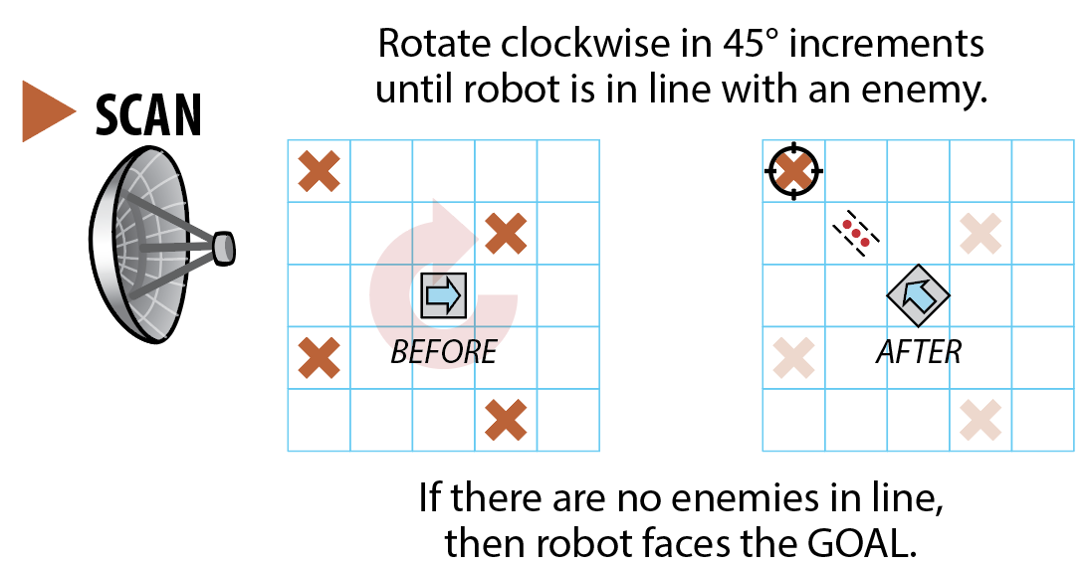
The Robot

Slide 27
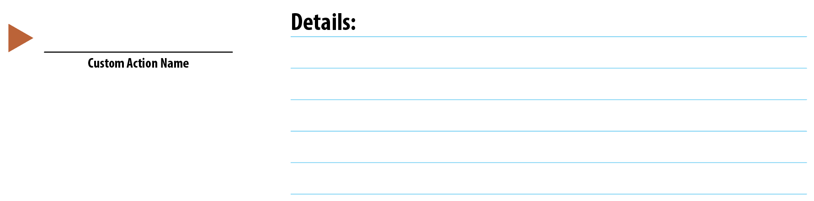
The Robot
Save this section for later

Slide 28
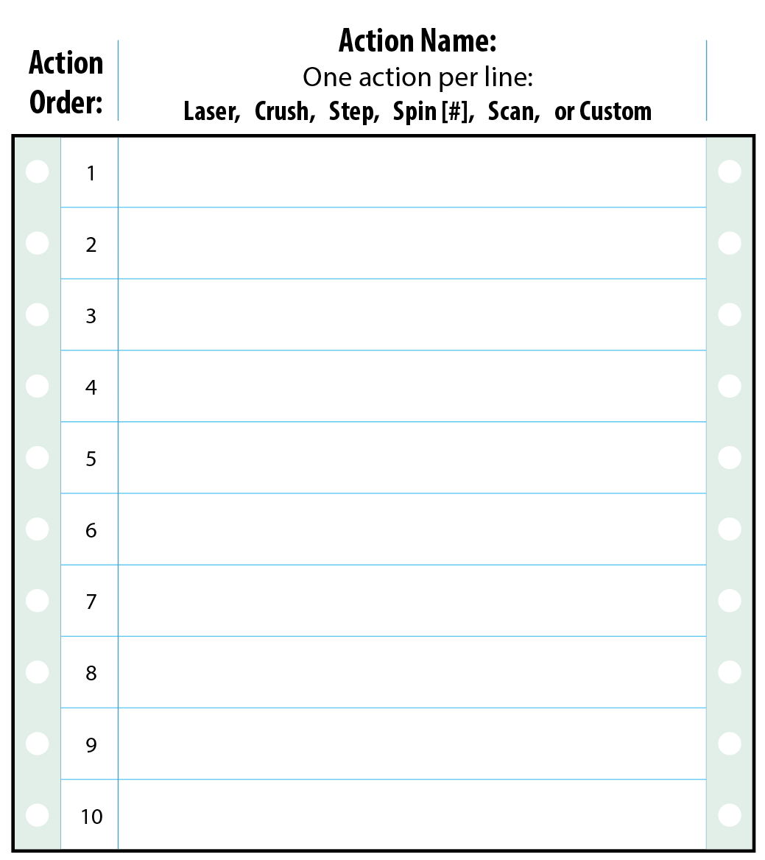
The Robot
Step
Scan
Laser
Step
Spin 2
Crush
Spin 4
Crush
Scan
Step
Each turn the robot attempts to perform the actions on its list in order from 1 to 10.
If an action cannot be performed then skip it and move on to the next action.
When the robot finishes the 10th action then its turn is over and the tanks start their turn.

Slide 29
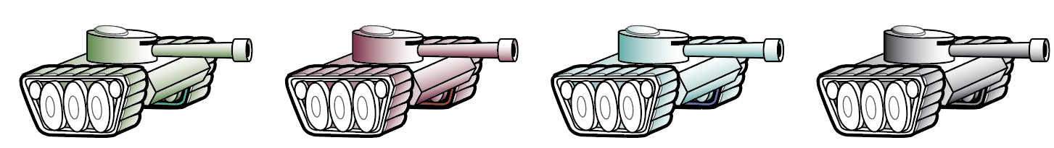
The Tanks
Each Tank gets to choose 3 ACTIONS in any combination:
Shoot straight forward for 1 damage.
You may shoot over other tanks.
Move straight forward 1 space.
You may not move into the same space as another tank or the robot.
Rotate to face any direction. (Orthogonal or diagonal)

Slide 30


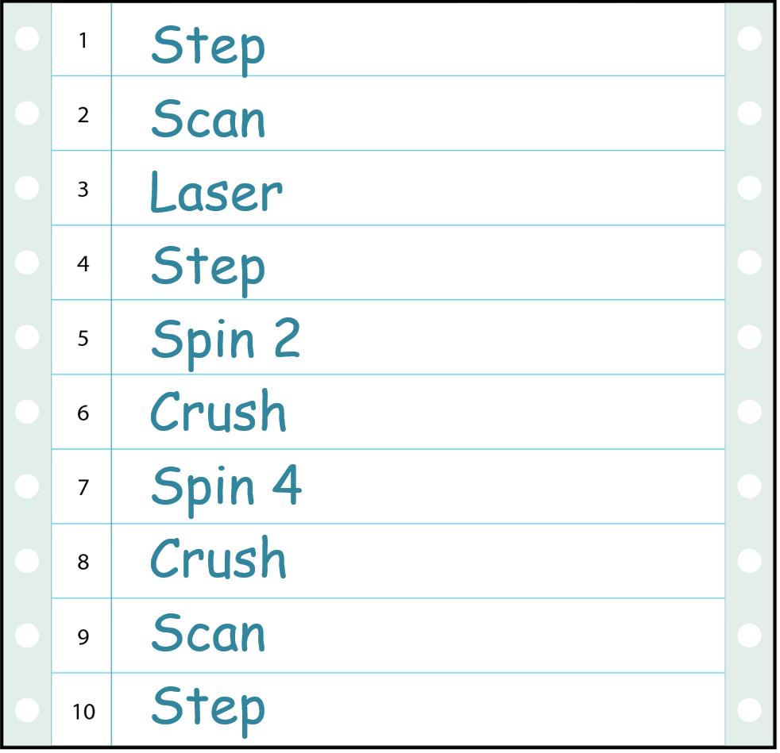
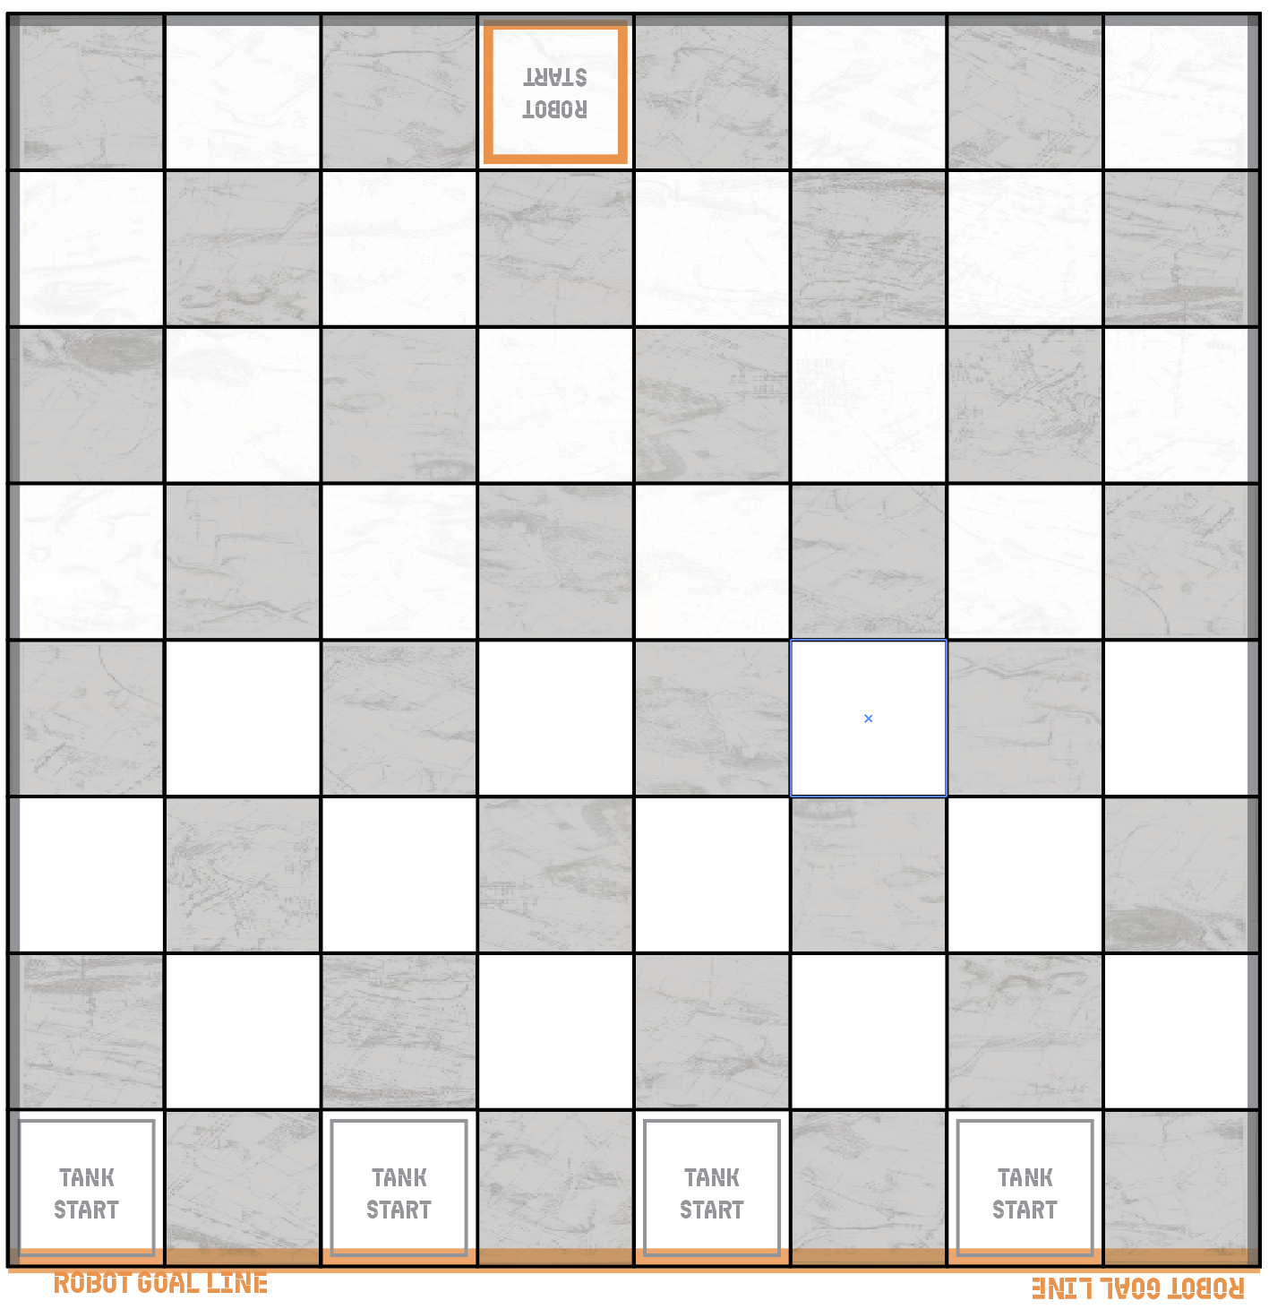
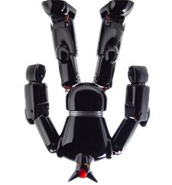
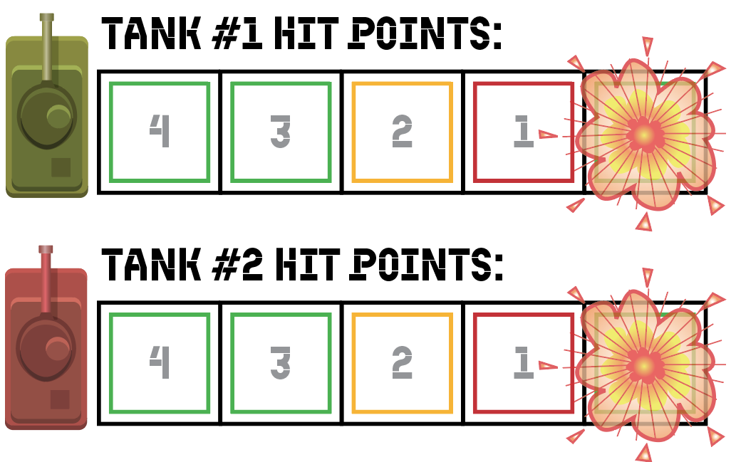
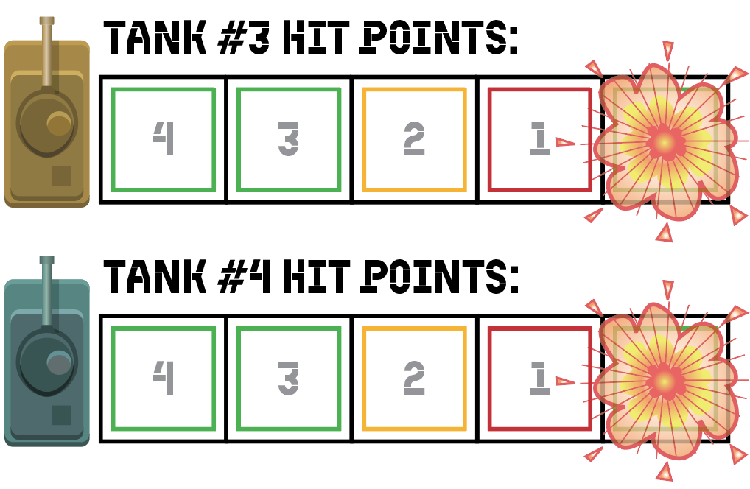




Demo Game

Slide 31
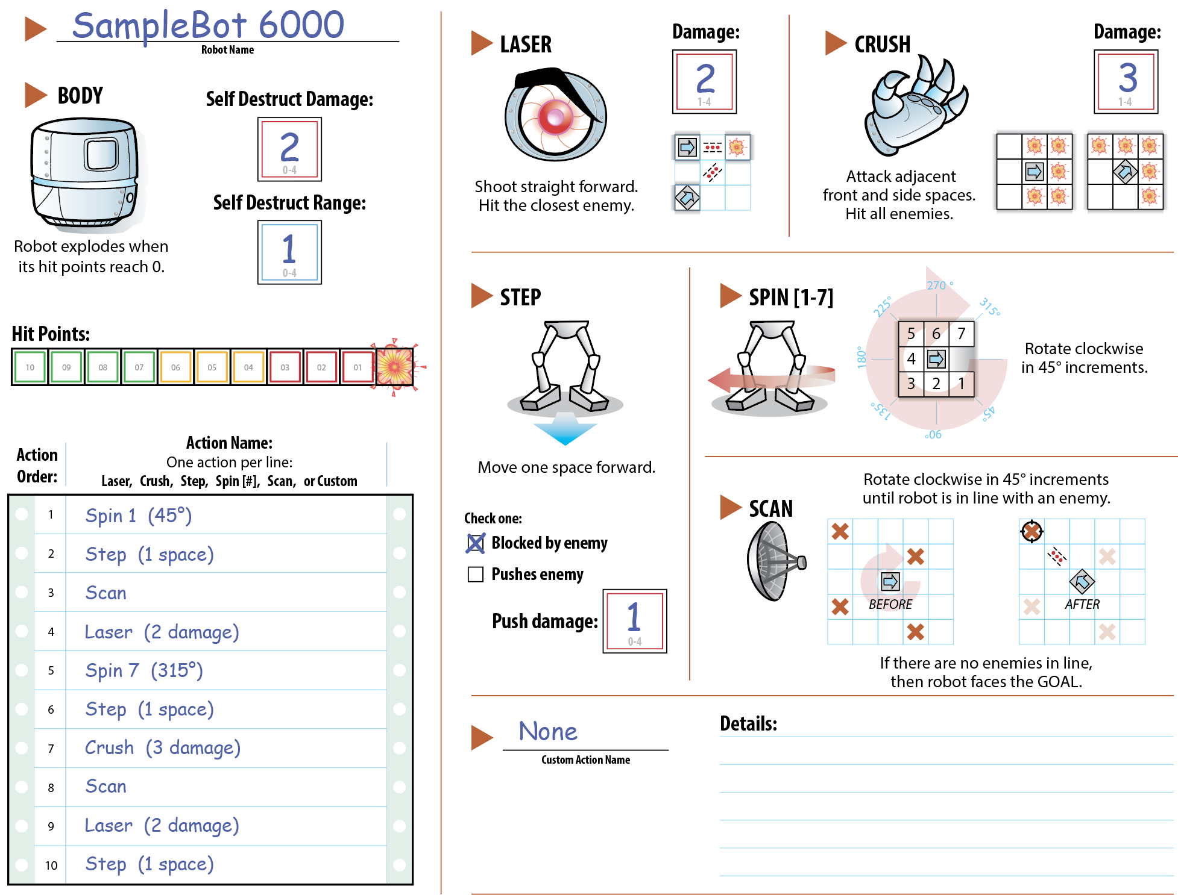

Slide 32
Questions or Comments?

Slide 33
Your Mission:
Create a robot that maximizes drama.

Slide 34
Program your own Robot
You can specify:
Sequence of Actions
LASER Damage
CRUSH Damage
STEP and SPIN
SCAN

Slide 35
Battle!
Play until 4:10
Set up the game board
Robot goes first and does all 10 actions in order
When Robot finishes, each Tank takes 3 actions
  Shoot
  Move
  Rotate
Alternate Robot and Tanks until one side wins

Slide 36
Battle!
Play until 3:40
Set up the game board
Robot goes first and does all 10 actions in order
When Robot finishes, each Tank takes 3 actions
  Shoot
  Move
  Rotate
Alternate Robot and Tanks until one side wins

Slide 37
Targeting
Action Order
Damage
??
Drama
Mechanics
Dynamics
Aesthetics
Notes:
37

Slide 38
What Dynamics Create Drama?
What is the most dramatic outcome?
What is the most dramatic path to that outcome?

Slide 39
Dynamics of Drama:
Uncertainty
Inevitability (i.e. a “ticking clock”)
Building to a climax

Slide 40
Targeting
Action Order
Damage
Uncertainty
Ticking Clock
Ramp
Drama
Mechanics
Dynamics
Aesthetics
Notes:
40

Slide 41
Iterate Towards Drama
Fail faster!
Try to get in many iterations
Play complete games
Archive your iterations
Take Notes
Focus on the dynamics: Uncertainty, Ticking Clock, Ramp
Work until 5:00

Slide 42
Add a new feature
Attack
Weapon
Rule
Don’t ruin the drama
Don’t change the tanks!
Fail Fast!
Have an alpha version by 5:25

Slide 43
Beta Test at 5:35
Write your beta version down on the submission sheet
Make sure your robot has a name!

Slide 44
Iterate Towards Drama
Fail faster!
Try to get in many iterations
Play complete games
Archive your iterations
Take Notes
Focus on the dynamics: Uncertainty, Ticking Clock, Ramp
Work until 4:30

Slide 45
Add a new feature
Attack
Weapon
Rule
Don’t ruin the drama
Don’t change the tanks!
Fail Fast!
Have an alpha version by 4:55

Slide 46
Beta Test at 5:05
Write your beta version down on the submission sheet
Make sure your robot has a name!

Slide 47
Drama in Us vs. It
Uncertainty
  Behavioral Complexity
Inevitability
  March towards Goal
  Decreasing Hit Points

Slide 48
Discussion
What other mechanics can create uncertainty?
Randomness
Hidden Information
Skill challenges
Negative Feedback
Escalation

Slide 49
Discussion
What other mechanics can create inevitability?
Time Limit
Pace monster
Non-renewable resource
Non-reversible process

Slide 50
Discussion
When does the climax occur?
What is the role of the Self Destruct mechanic?

Slide 51
Summary
“Dramatic” does not mean “Scripted”
Drama emerges from game dynamics
  Inevitability
  Uncertainty
  Building to a climax
Embedded vs. Emergent Narrative

Slide 52
What we can
Change
What we can
Observe
How
Players React
(Emotionally)
Mechanics
Dynamics
Aesthetics
Notes:
52

Slide 53
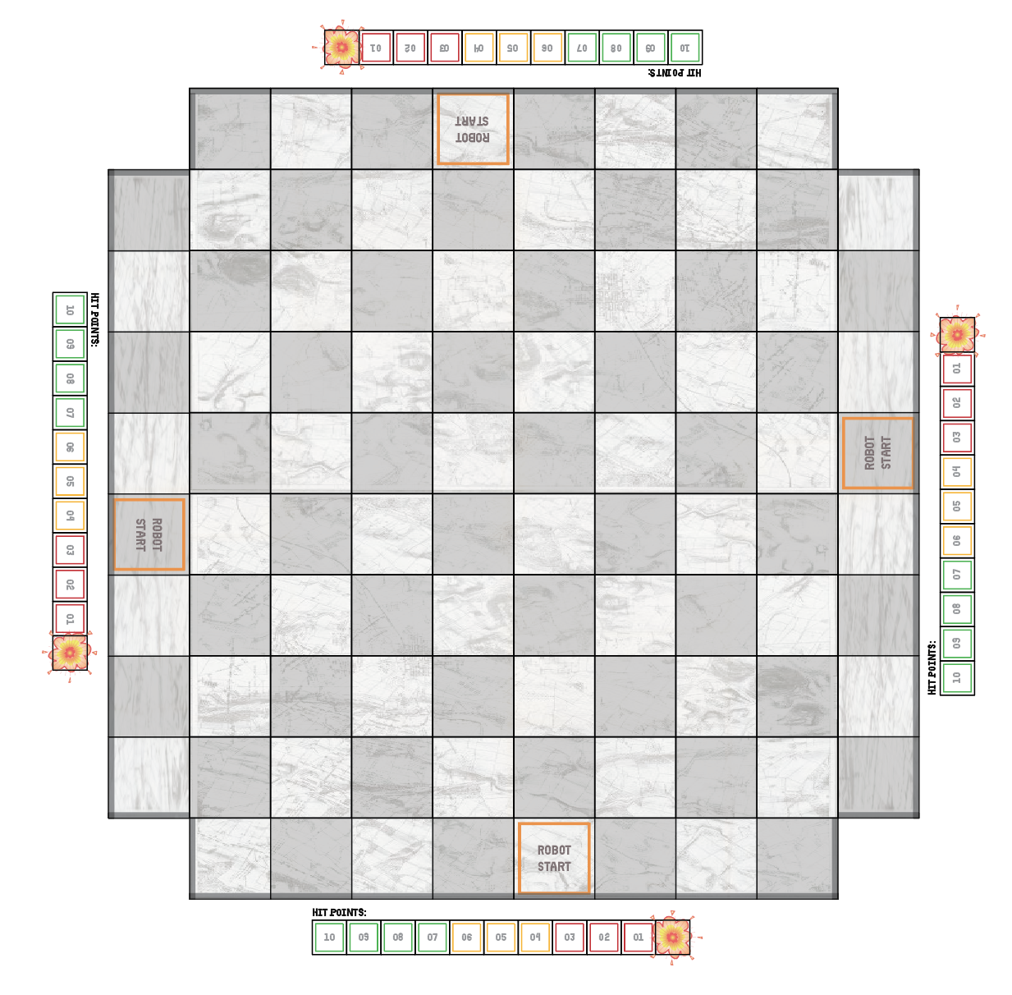
Robot battle!
No tanks!
  Rules that reference “tanks” now refer to “robots”
All robots perform action 1, then all robots perform action 2, etc.
  After action 10, loop back to action 1.
  Robots without an action skip that phase
Gameplay is completely automatic
  Keep going until only 1 robot remains!

